Slide 1
The Puritans & The Salem
Witch Trials

Slide 2
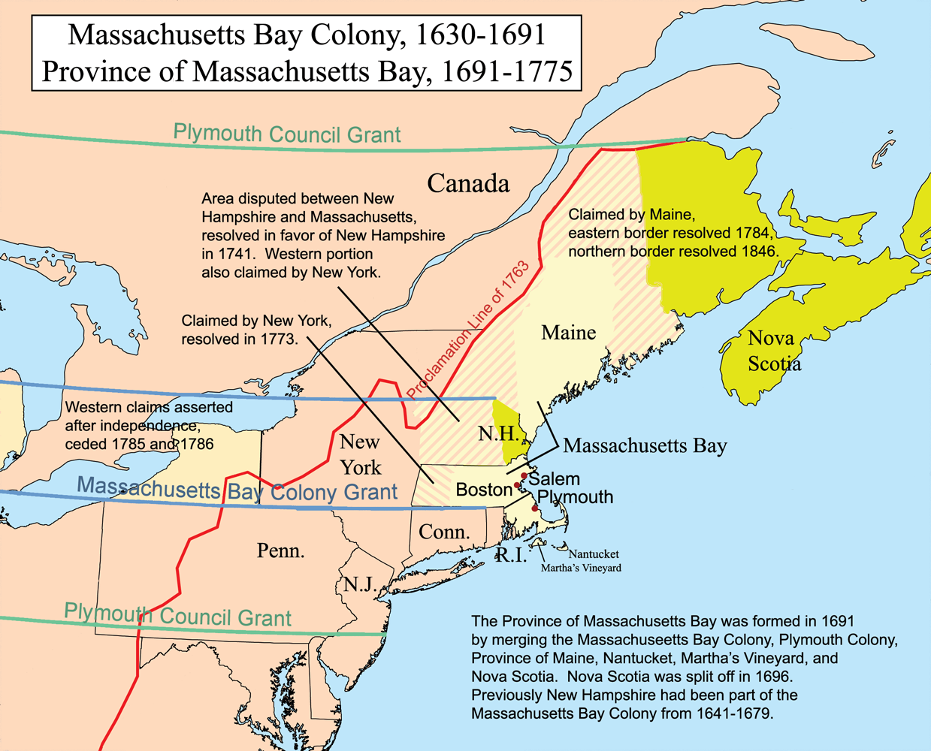
Who were the Puritans?
Wanted to reform the Church of England by eliminating all things Catholic
Left for The New World (America) in 1620 to escape religious persecution
Established the Massachusetts Bay Colony

Slide 3
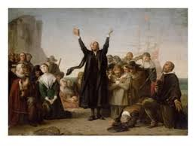
Puritan Beliefs
Total depravity: Humankind is totally evil through the fall of Adam and Eve and is therefore damned for eternity.
Predestination: A person is “elect” (saved) or “unregenerate” (damned) before he/she is born. God has already chosen who will go to Heaven.
Limited atonement: Jesus died only for the “elect,” or those chosen by God.
Irresistible Grace: God sends the Holy Spirit to the “elect”--and only the “elect”--to allow them to repent, have faith, and be eligible for eternal life (Heaven). Those chosen by God will be drawn to him like a magnet. The “unregenerate” will never receive the Holy Spirit.

Slide 4
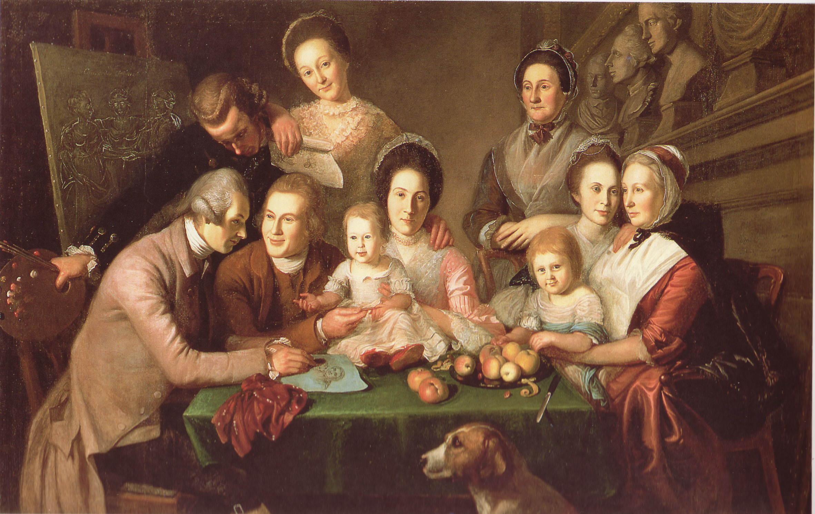
Puritan Beliefs continued
The Puritan community was a theocracy--a government that blends church and state. In other words, the church officials were the government officials.
They wanted the new Massachusetts Bay Colony to be a utopia consisting of Godly scripture and a strong work ethic.
Education was emphasized in order to be able to read the Bible. They founded the first public school in 1835.

Slide 5
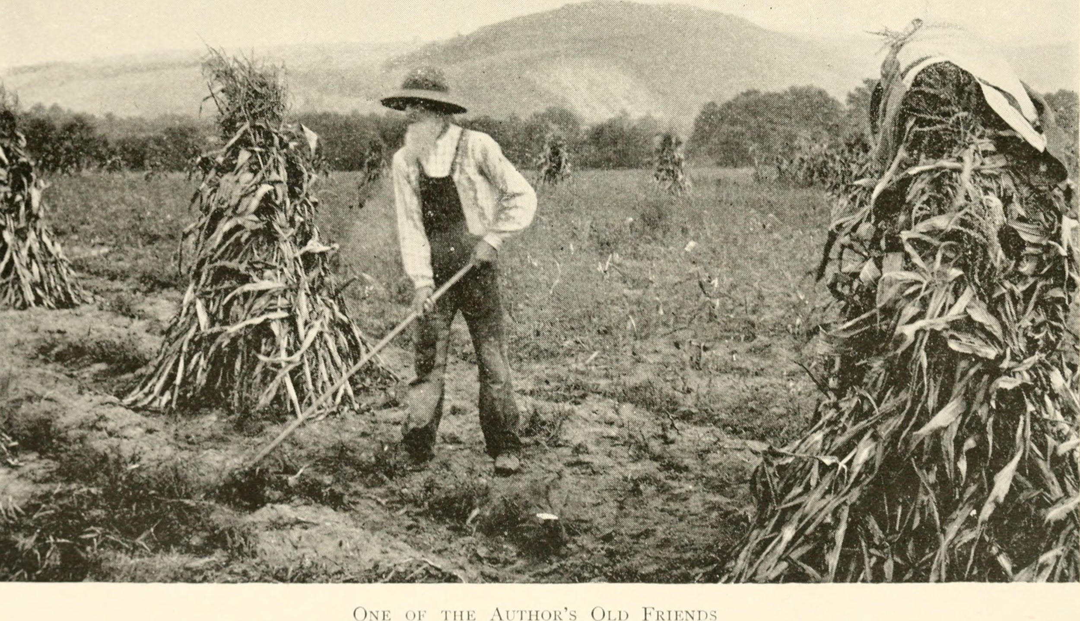
Creating an American National Identity
The Puritans were the first to build upon the idea of the American Dream.
They valued independence, patriotism, industry, practicality.
They believed that new paths could be forged and goals could be attained.
From them, we inherited...
an emphasis on hard work
a strong sense of religion
duty to our country
freedom from oppression

Slide 6
The Puritan Moral Code
1. It was against the law to miss church.
2. Men and women had to sit on opposite sides of the church when service was in session.
3. People were expected to work hard and they were not allowed to express their own opinions or emotions.
4. Individualism was frowned upon. You had to conform to society’s norms or you would be shunned (avoided).
5. The way Puritans dressed was controlled by the church. They wore dark, somber, and modest outfits.
6. Puritans believed that all sins--even the most “minor” to us nowadays--should be punished. For example, if you
were having a good time (laughing or enjoying something), you were probably happy and it was considered a sin.
7. All songs had to have a moral lesson in them (like religious hymns), or else they were sinful.
8. They believed God would punish sinful behavior.
9. If a friend or neighbor suffered a misfortune (like a sick child or a bad farming year), Puritans believed it was
God’s will and they would not help.
10. Puritans were true believers in both God and the Devil. They believed that all humans were in a constant struggle between the powers of good and evil.
11. They believed that Satan would select the “weakest” individuals (women, children, and the elderly) to carry out
his evil work.
12. Those who were believed to follow Satan were automatically assumed to be witches, which was a crime
punishable by death.

Slide 7
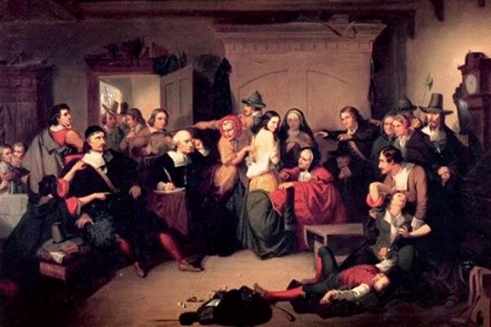
The Salem Witch Trials
A young girl, Betty Parris, became strangely ill,
doctor suggested that it could be supernatural
The Puritans’ widespread belief that witches targeted children made this diagnosis seem increasingly likely.
By the end of 1692, over 200 people were jailed and facing accusations of witchcraft.
Nineteen men and women were convicted of witchcraft and hanged.
One man was pressed to death under heavy stones for refusing to be tried for witchcraft.
Many people were kept in jail for months without trials.
At least four people died in jail.

Slide 8
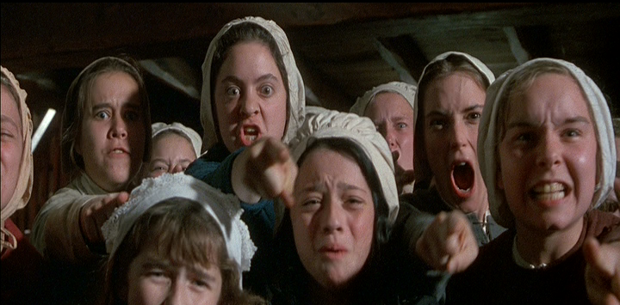
Mass Hysteria
Mass Hysteria: a collective delusion or threat to society that spreads rapidly through rumors or fear
In our simulation activity, you were a victim of mass hysteria. You believed that someone cheated and worked to find the cheater, despite not having any evidence. This is because you were afraid that, if you did not accuse someone, you and your friends would not graduate. In this situation, your ability to reason was pushed aside and replaced by fear and anxiety.
Can you think of any other “witch hunts,” or examples of mass hysteria in modern society?

Slide 9
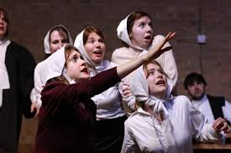
Causes of Hysteria and “Witchcraft”
Strong belief that Satan is present in the world
Belief that Satan actively recruits witches and wizards
Belief that a person afflicted with witchcraft exhibits certain symptoms
A time of troubles, which made it seem like Satan was active:
Factions (or groups) splitting up the church in Salem
Frontier wars with Indians
Stimulation of imaginations (by Tituba)
Confessing “witches” added credibility to previous charges

Slide 10
Possible “Causes” of Strange Behavior
Ergot poisoning: Ergot is a fungus that causes hallucinogenic effects similar to those of LSD. It is often found in grains like rye, which was the Puritans’ main crop.
Fearful girls: Children were seen as a source of labor and were not given much affection. They were often warned about the dangers of going to Hell.
Attention-seeking children: The girls lacked affection and attention, and were generally bored with life in the strict Salem village.
Economic jealousy: Old problems between accusers and the accused (especially over land) sparked witchcraft charges for personal gain or revenge.

Slide 11
Why the Hysteria Ended cont.
The highly educated population in Boston encouraged the governor of Salem to exclude spectral evidence, or a witness’ testimony that another person’s shape or spirit appeared to them in a dream or while the person’s actual body was in a different location.
Increase Mather, an important minister in Boston, pointed out that the Devil could also take the shape on innocent people: “It were better that 10 suspected witches should escape than one innocent person should be condemned.”
After, the governor of Salem finally barred spectral evidence and disbanded the Court.

Slide 12
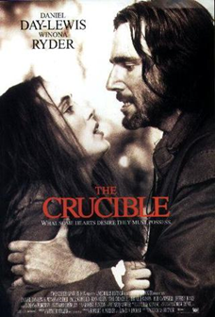
The Crucible by Arthur Miller
Written in 1953 by Arthur Miller
Set in Salem, Massachusetts (the Massachusetts Bay Colony) in 1692-1693
Miller’s play is based on history; It contains characters and events based on those that actually occurred during the Salem Witch Trials (with added romance for entertainment!).
Miller wrote The Crucible to deliver a modern message to society. He was inspired by the Second Red Scare (McCarthyism), and saw that “those who do not learn from history are doomed to repeat it.”

Slide 13
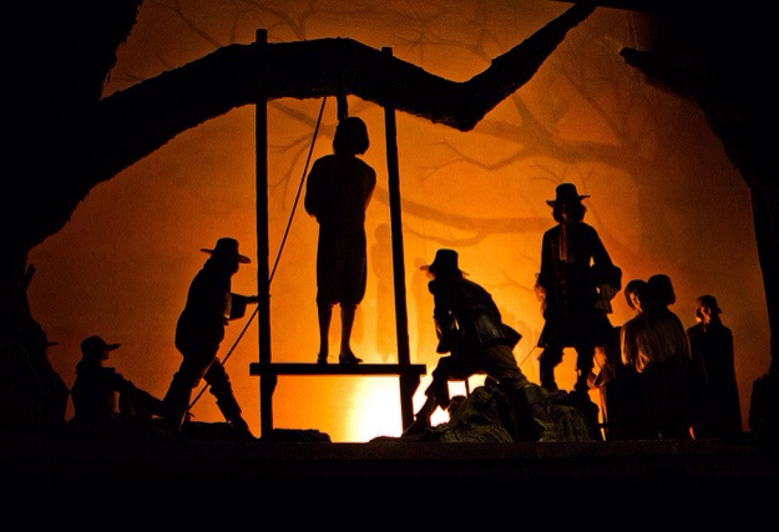
Why the Hysteria Ended
Doubts began to grow after respected citizens were convicted and executed.
Rebecca Nurse, an elderly and well-liked citizen of Salem, was accused of witchcraft. After the jury acquitted her case, they were urged to reconsider.
George Burroughs, another well-respected citizen, recited the Lord’s Prayer perfectly at his hanging--something a witch supposedly could not do.
Doubts grew stronger once powerful and well-connected citizens of Salem were accused, such as the governor’s wife.

Slide 14
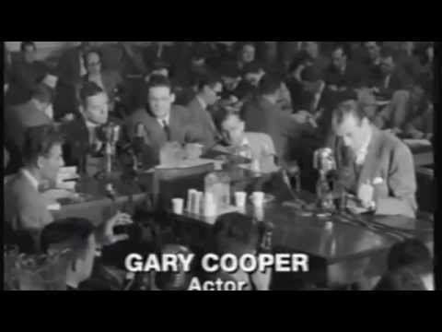
The Second Red Scare
Often referred to as McCarthyism after it’s most famous supporter, Senator Joseph McCarthy, the Second Red Scare took place after WWII.
Americans were afraid that communists (particularly from the Soviet Union) would threaten their idea of freedom.
The government formed the House Un-American Activities Committee to “hunt down” suspected communists in the U.S.
Many Hollywood stars were accused of practicing communism, and were put on the Hollywood Blacklist, which banned them from doing their jobs.
Arthur Miller, who was married to Marilyn Monroe at the time, was placed on the Hollywood Blacklist for writing The Crucible (an allegory for McCarthyism). He wrote it to remind people about the dangers of “witch hunts.”

Slide 15
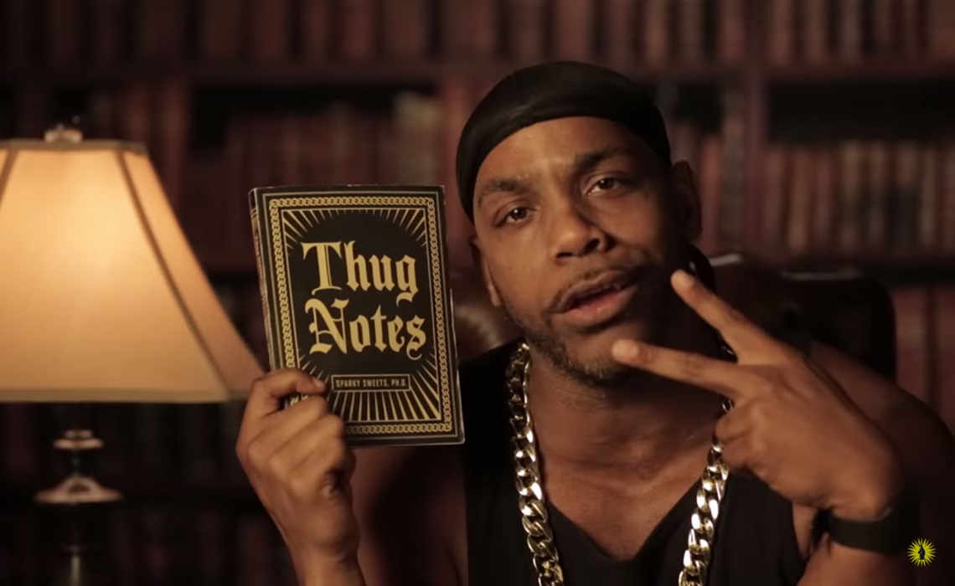
A preview:
Thug Notes
The Crucible

