Slide 1
Literary Themes
August 14 - 16

Slide 2

Wedsday, August 14th
Objectives: Students will understand the expectations of the course and will jump right in to speaking and listening, as well as providing reasoning for an opinion, on a non-threating topic while getting to know each other better.
Agenda:
Literary Themes
  Syllabus
Introductions
  Mrs. Manzella
  Ms. Owens

Slide 3
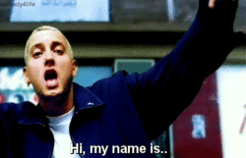
Thursday, August 15th
Objectives: Students will digitally introduce themselves.
Agenda:
Create a Power Point on OneDrive
  One slide with two sections like this
  Multiple slides
Introduce yourself to ME!
  Family - Dreams/Goals
  Friends - Future Career
  Hobbies - Places
  Anything you think I should know!
Share your slide(s) to fmanzella@d131.org

Slide 4

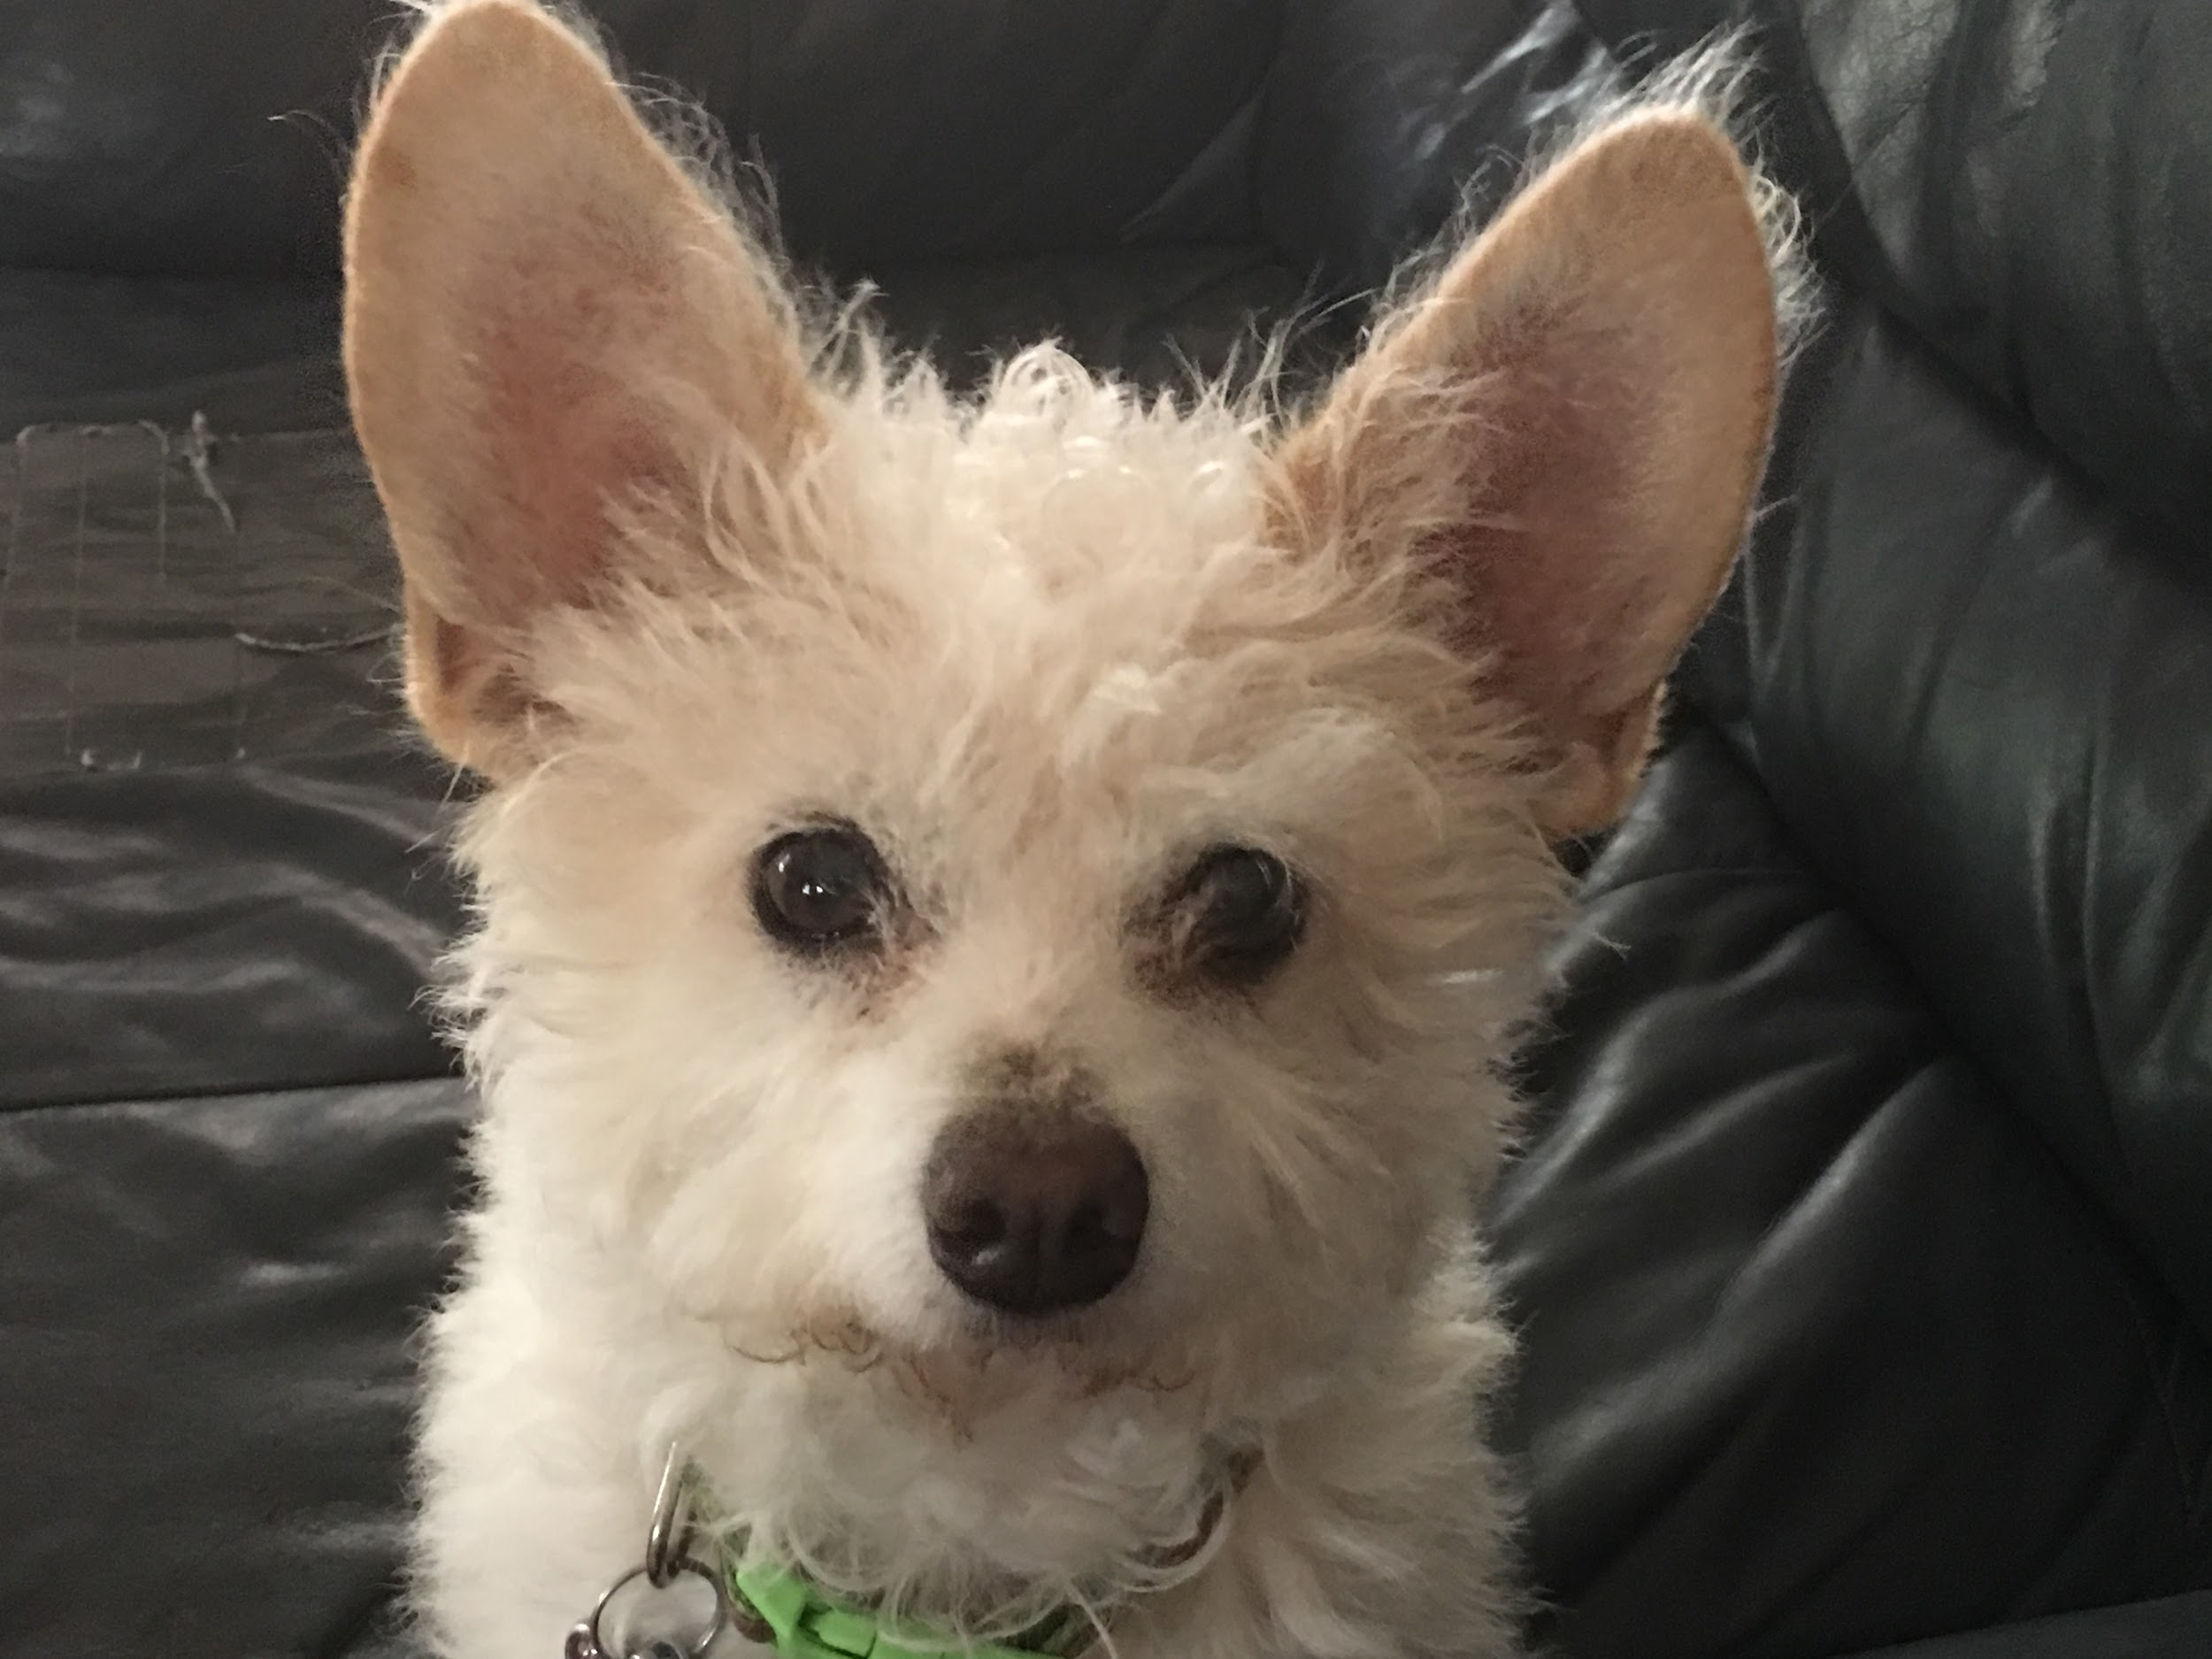
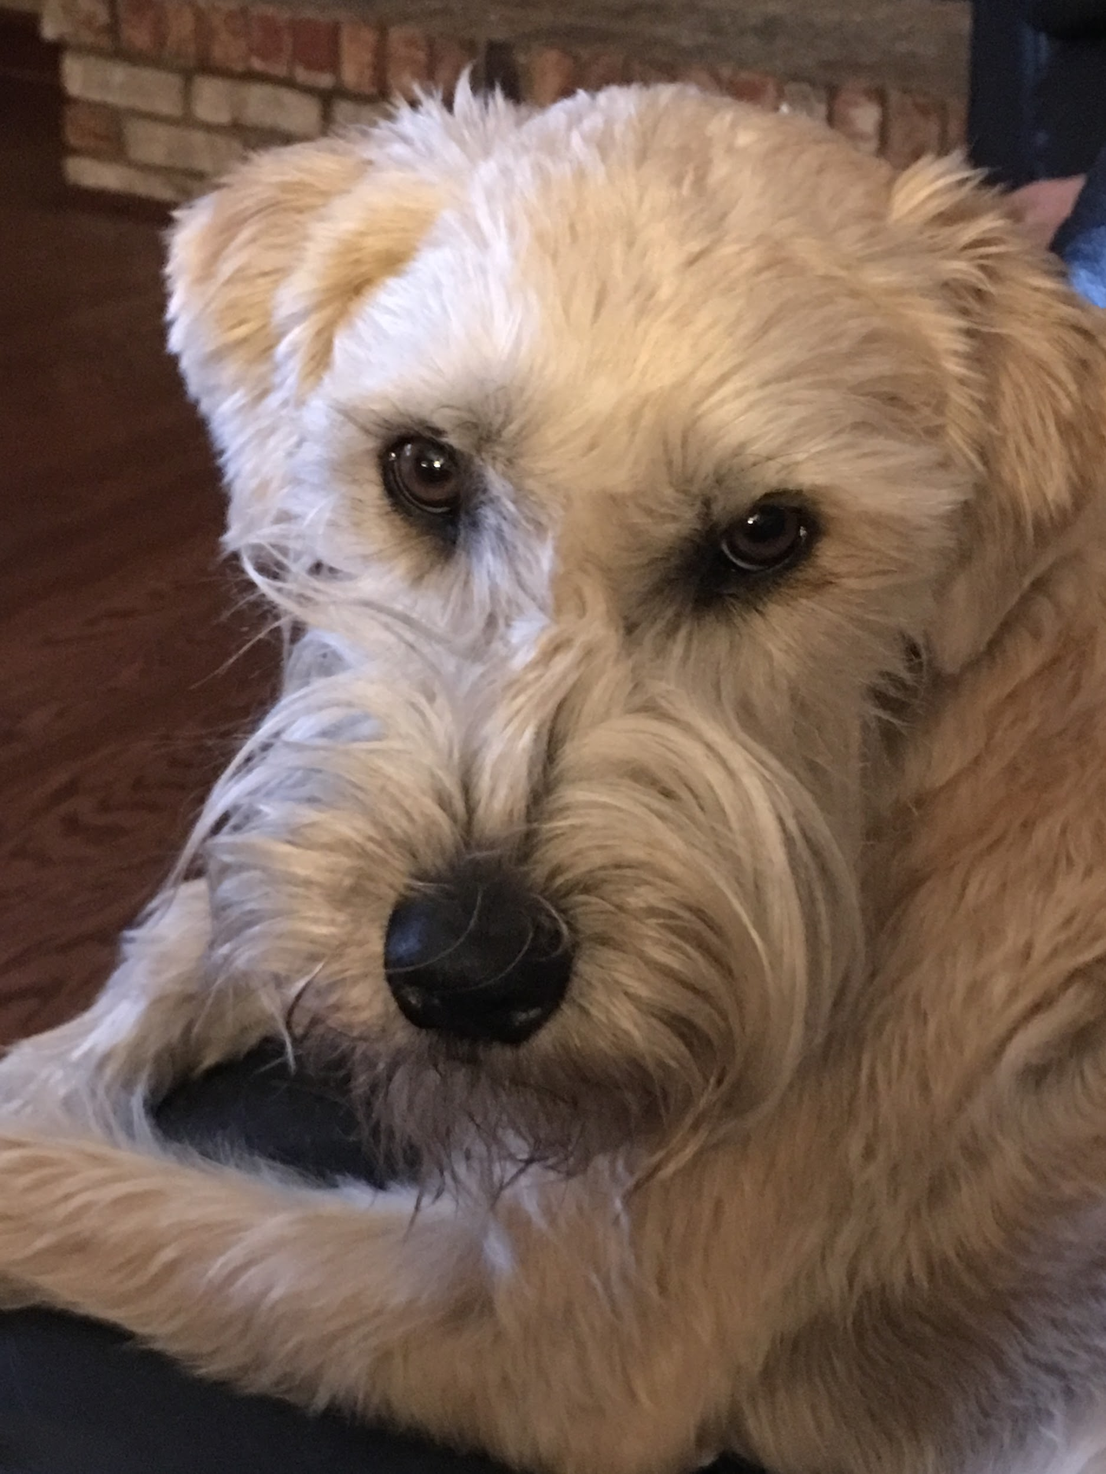

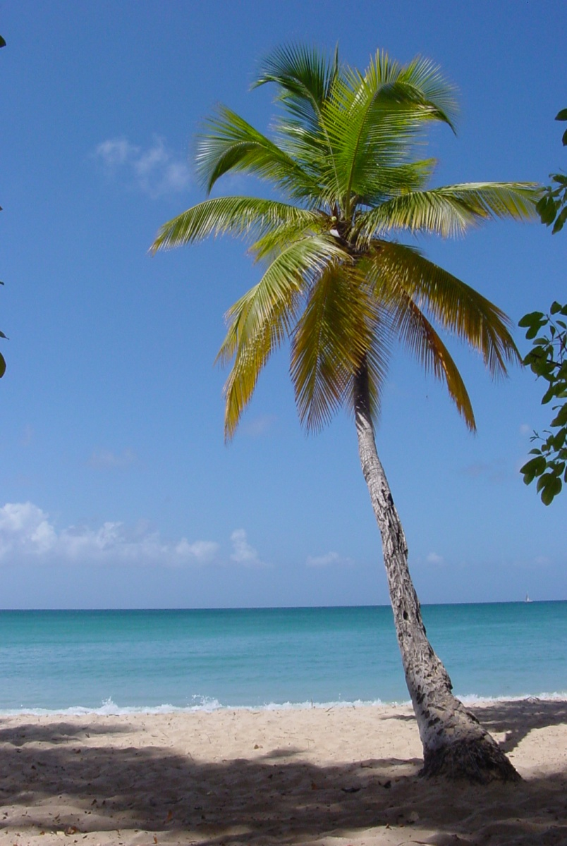


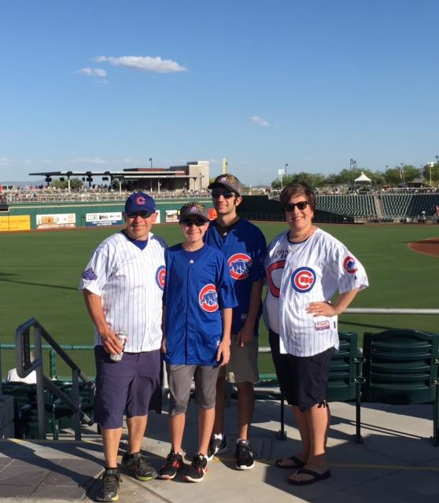
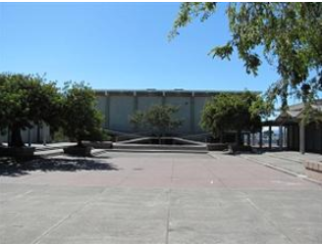

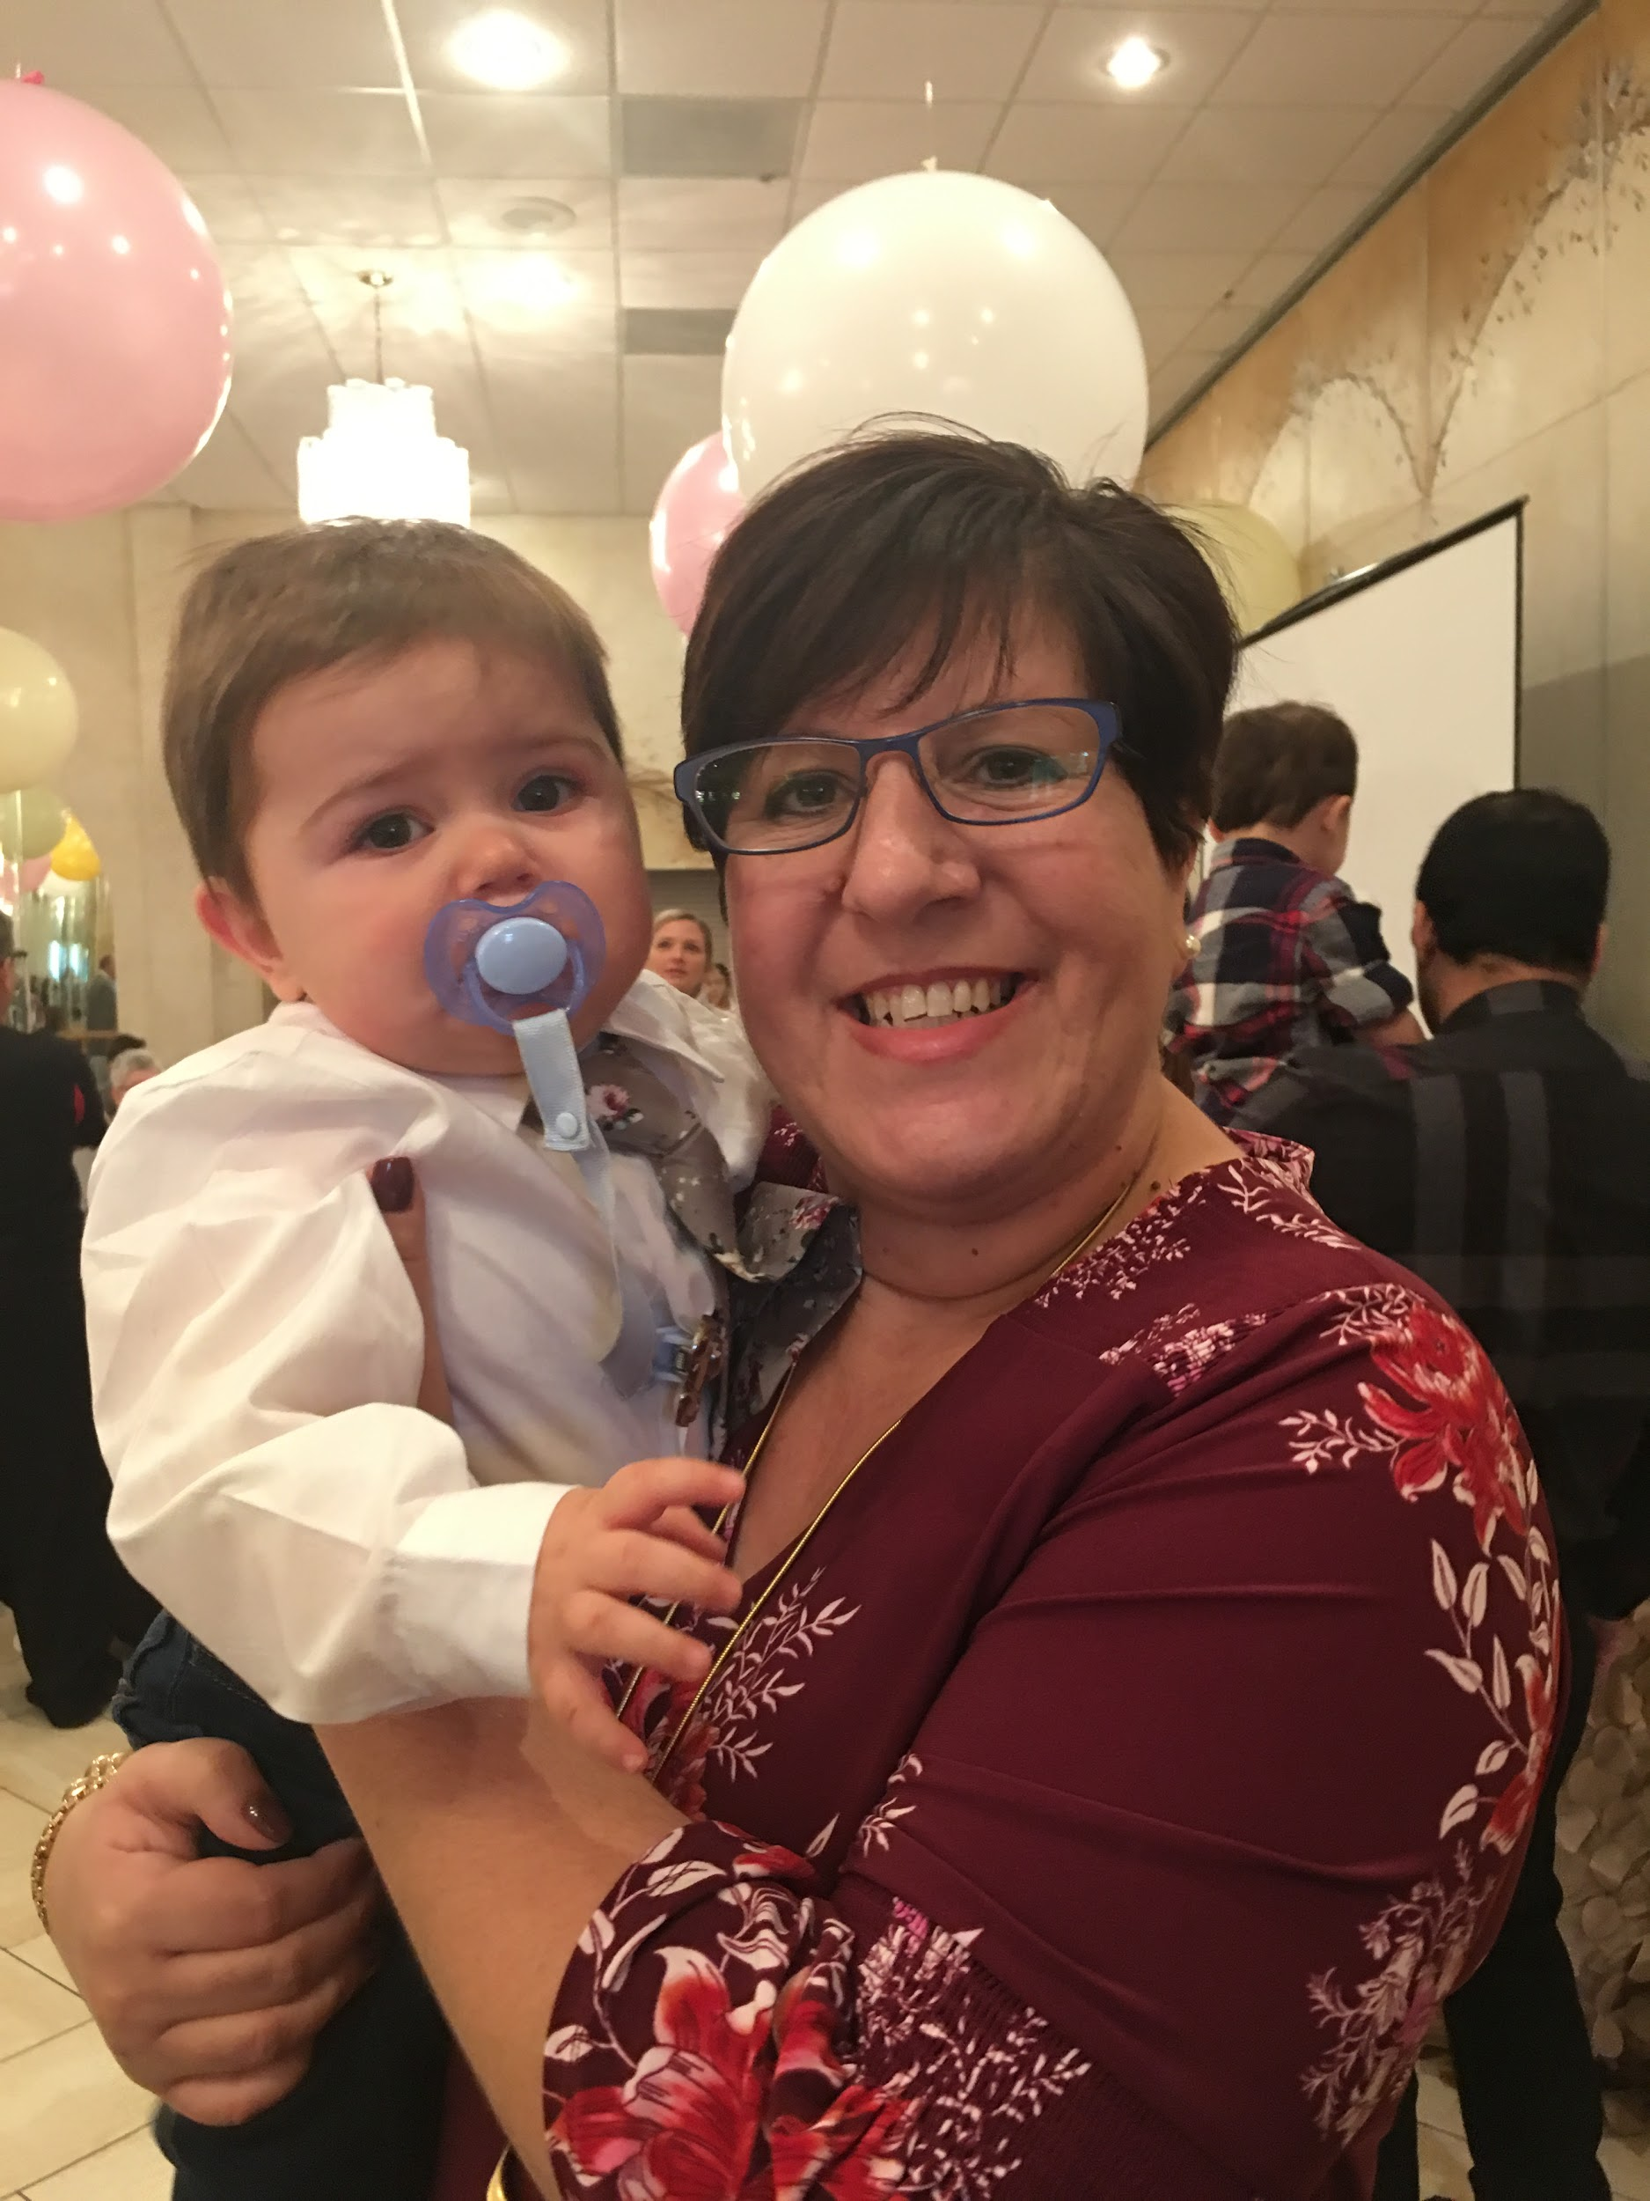
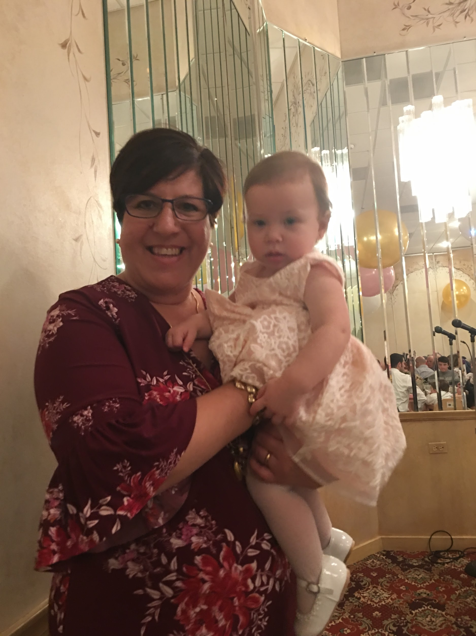

Mrs. Manzella
Family
  Oldest of three; 1 sister, 1 brother
  Married 20 years
    Mario, 17
    Frankie, 14
    Two doggies - Luna and Cubby
Schooling
  Elementary: St. John’s (grades 1 - 8)
  High School: El Cerrito High School
  College: San Francisco State University
  Masters: Concordia University
Teaching
  Student teaching: Berkeley High School
  Juan Crespi Middle School (3 years)
  East Aurora High School (20 years)
Interests
  Reading fiction
  Traveling, especially beaches
  Babies - 3 greats, one on the way

Slide 5
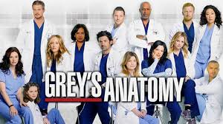
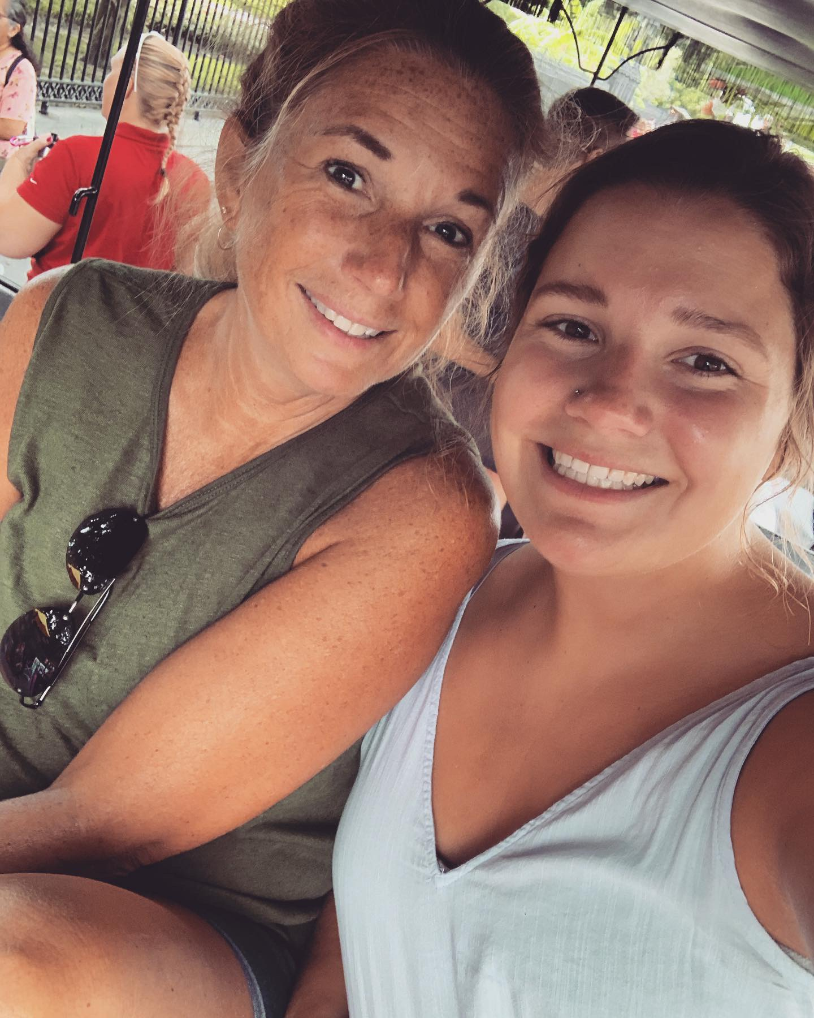
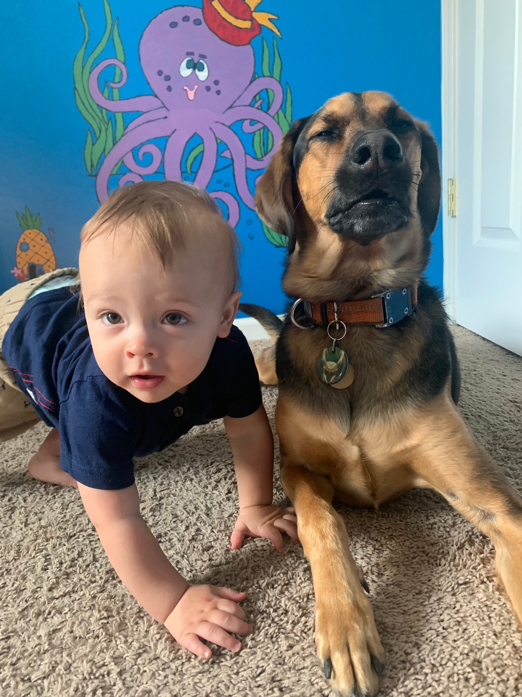
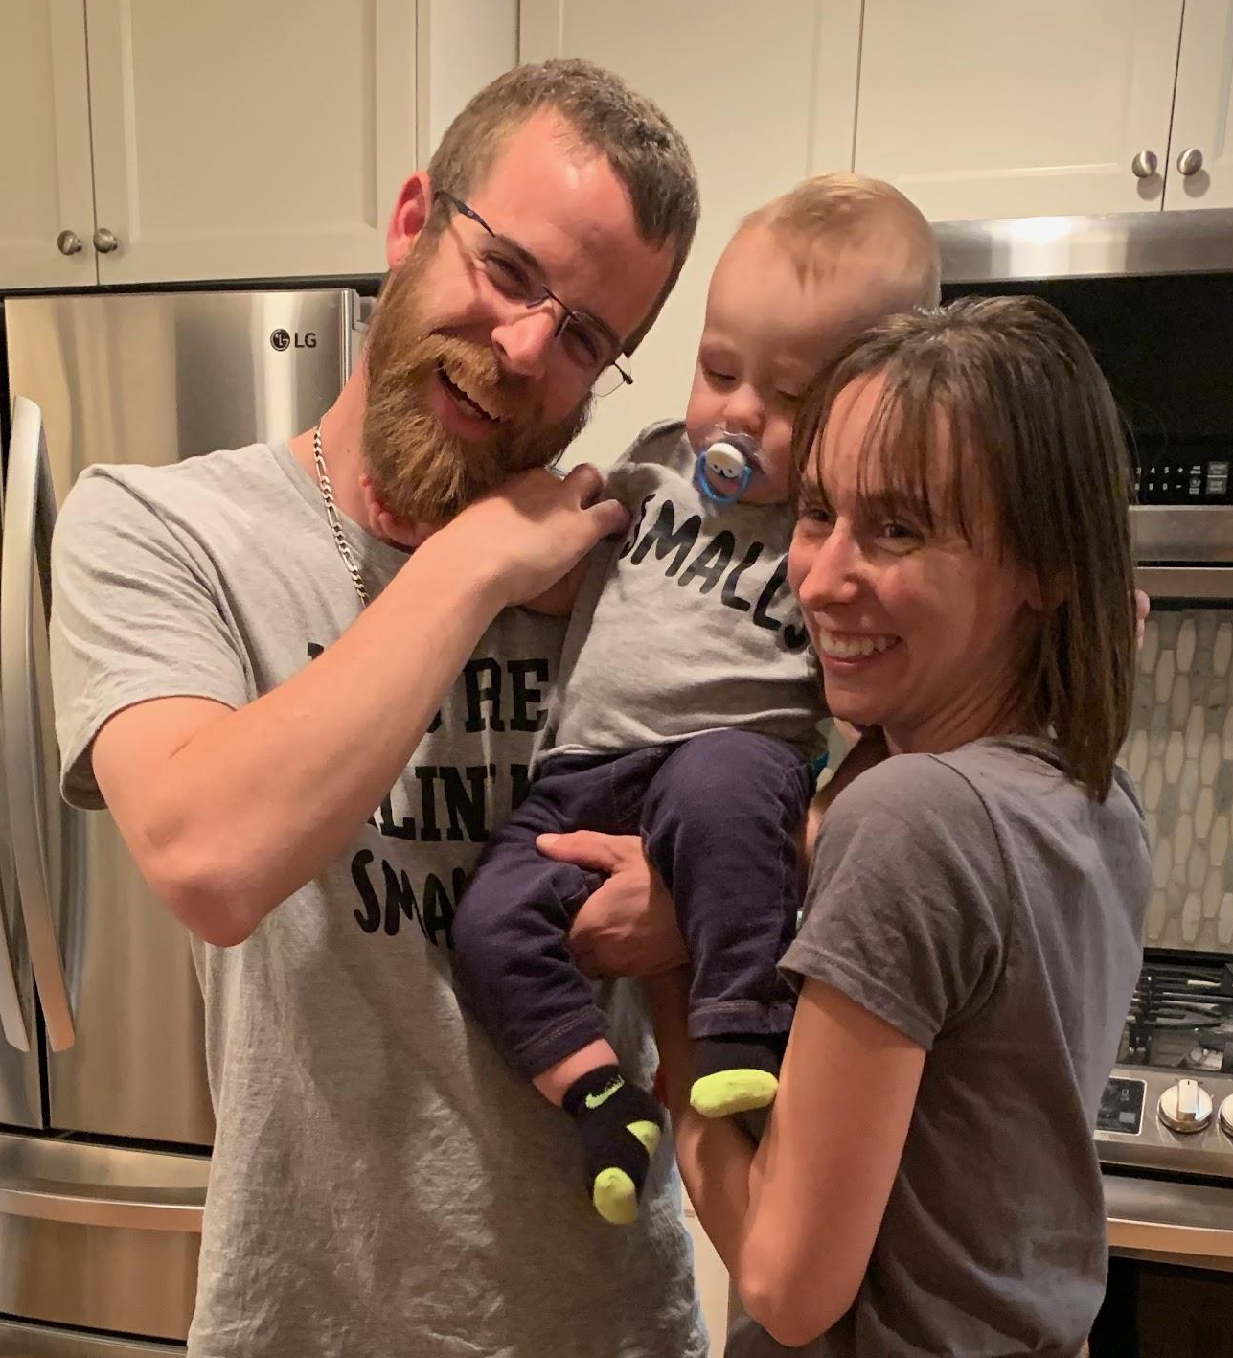
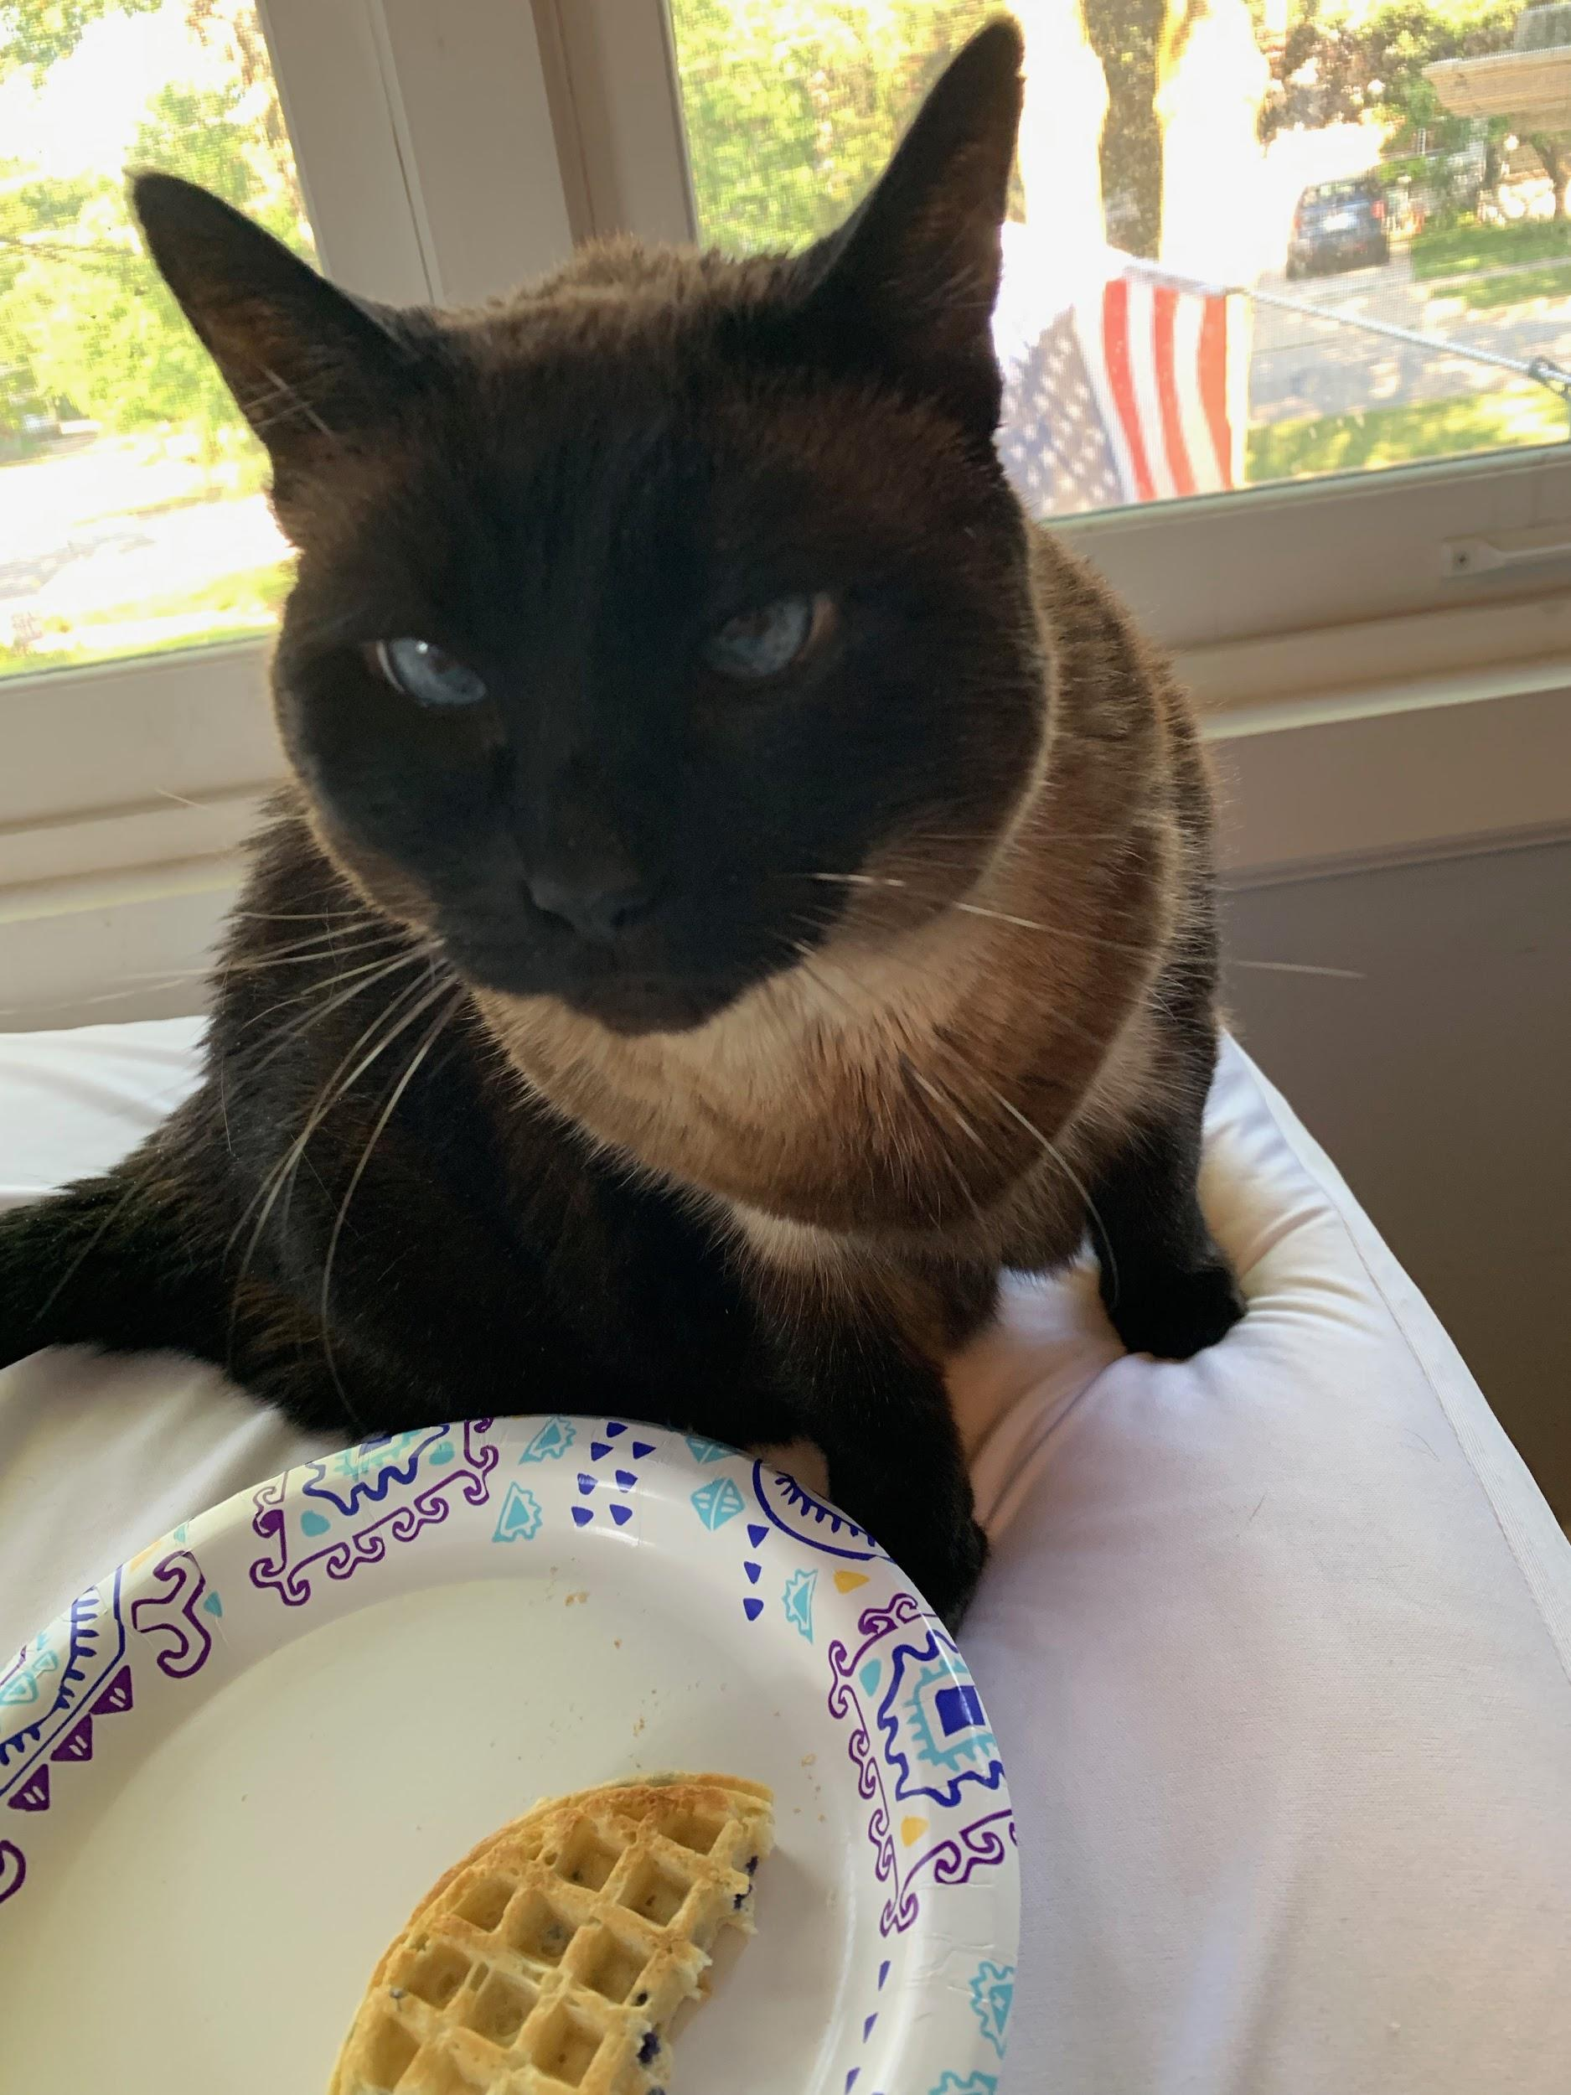
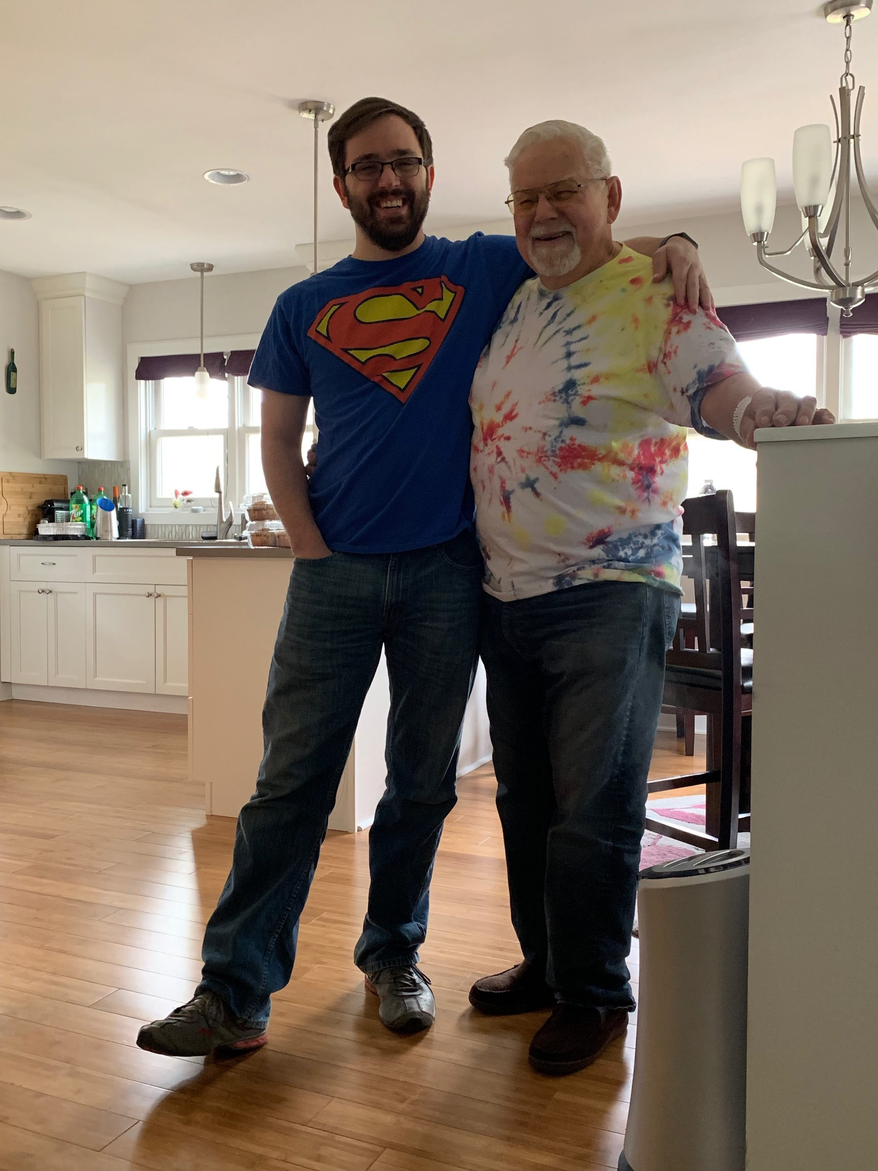
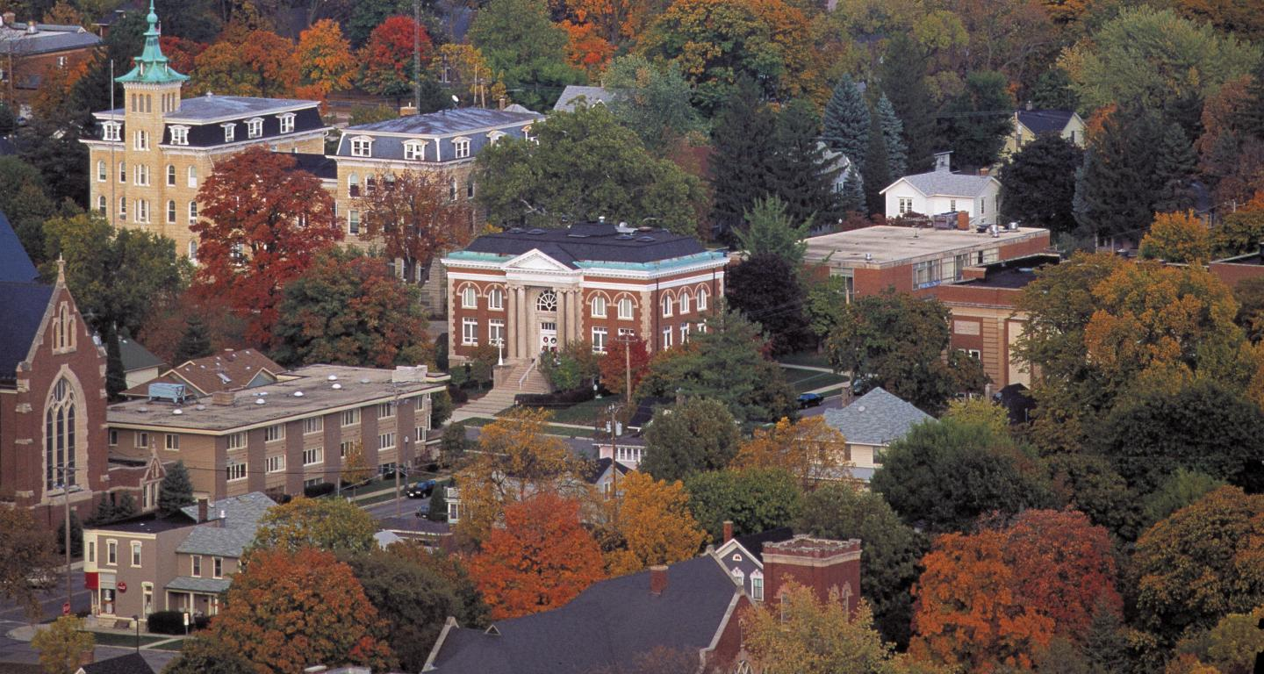
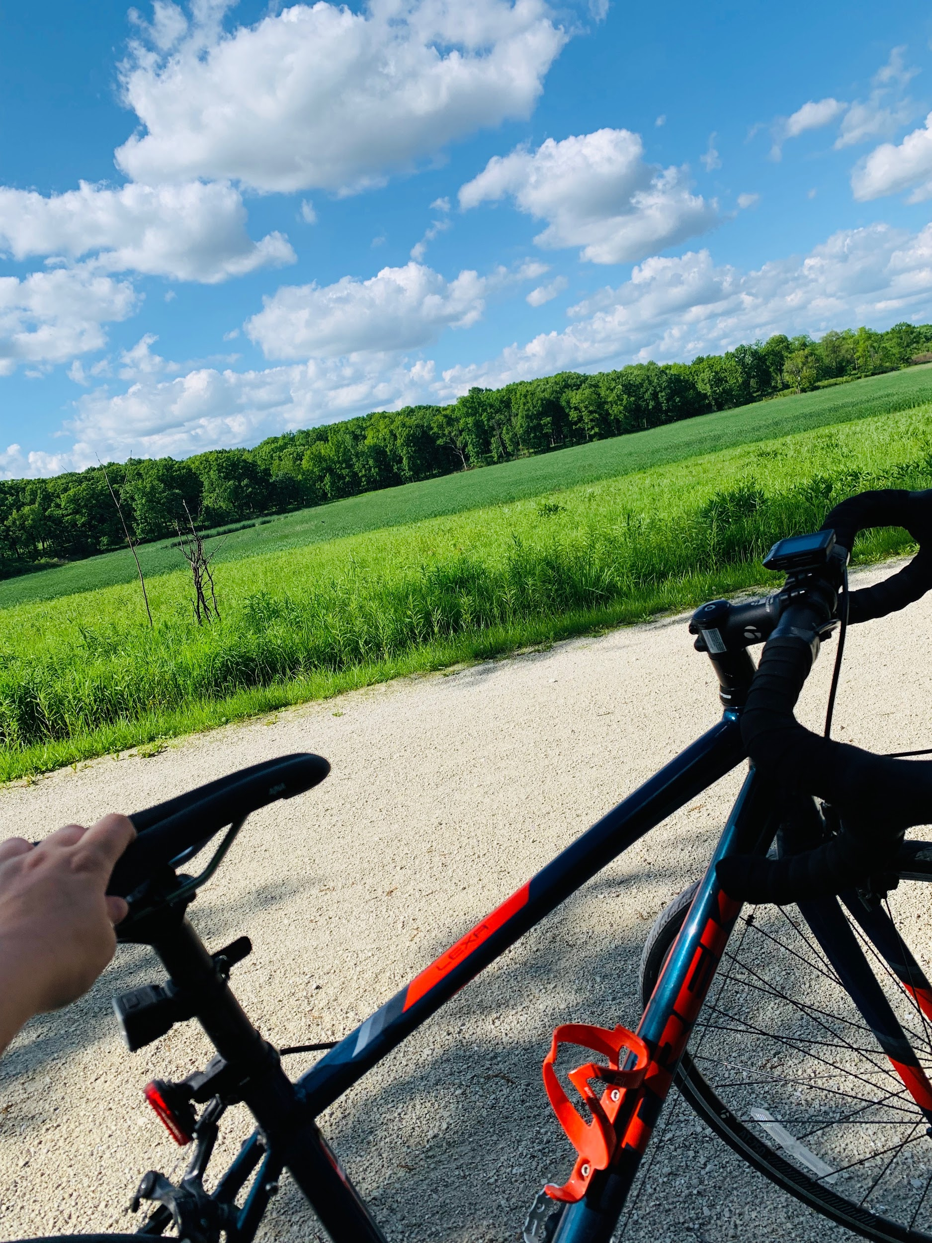
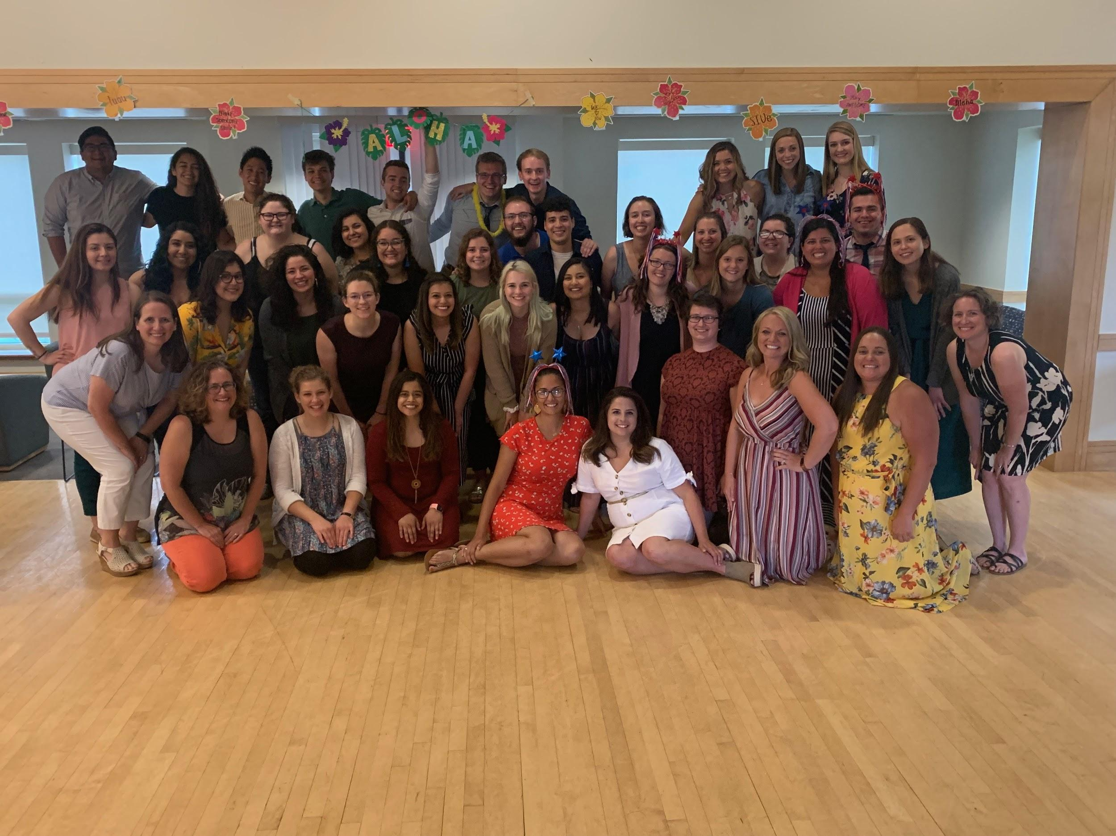
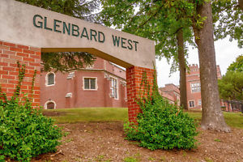
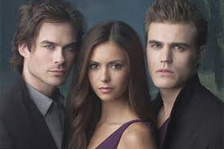
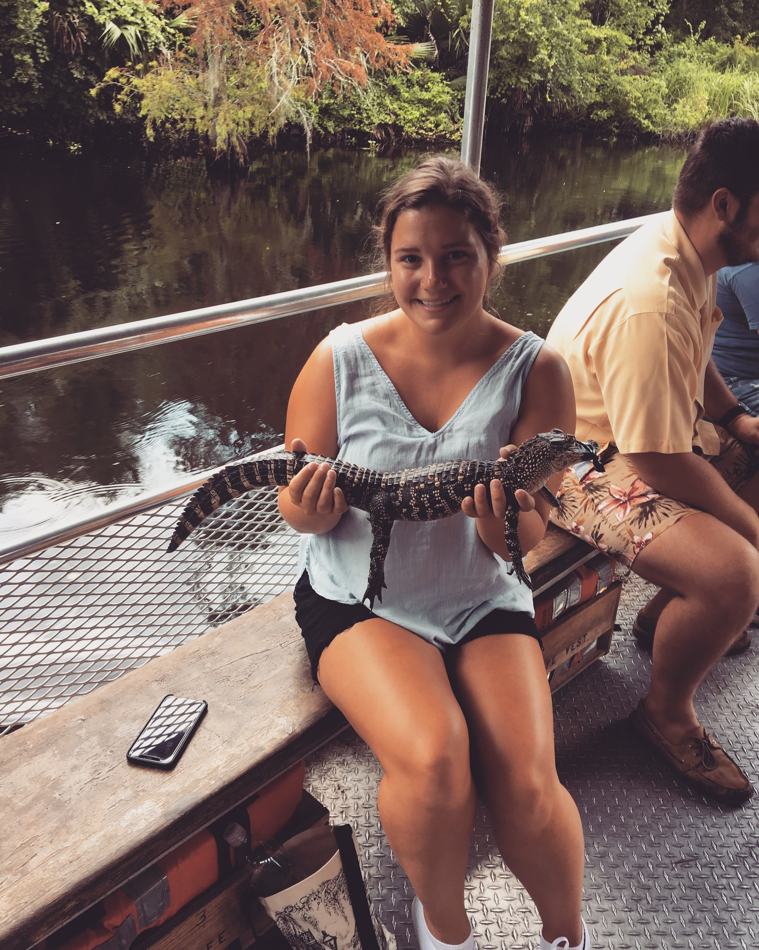
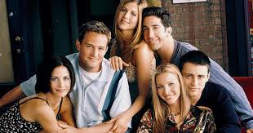
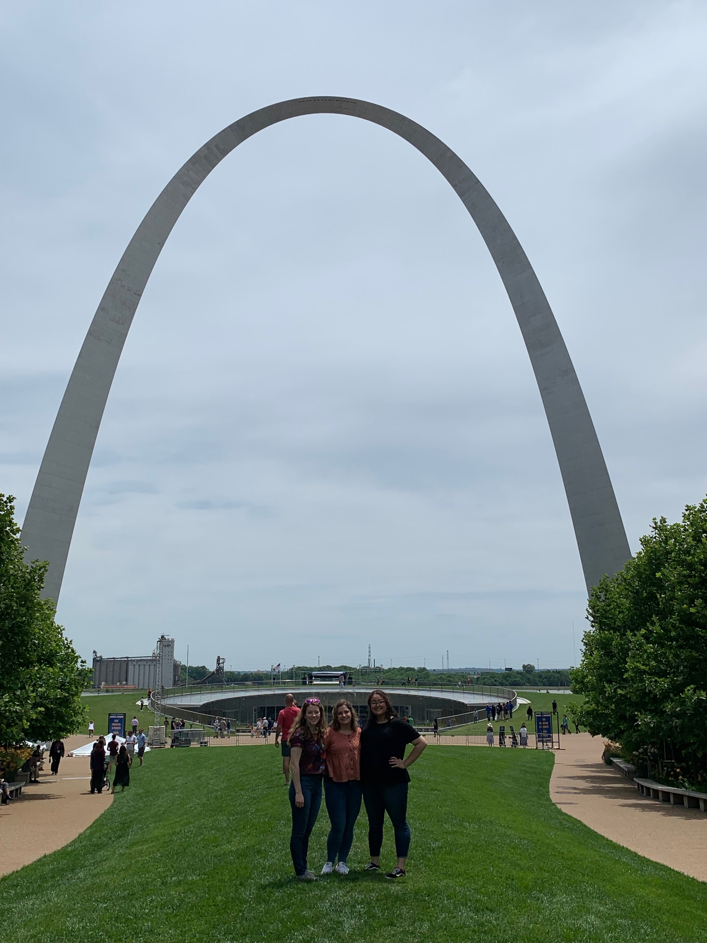
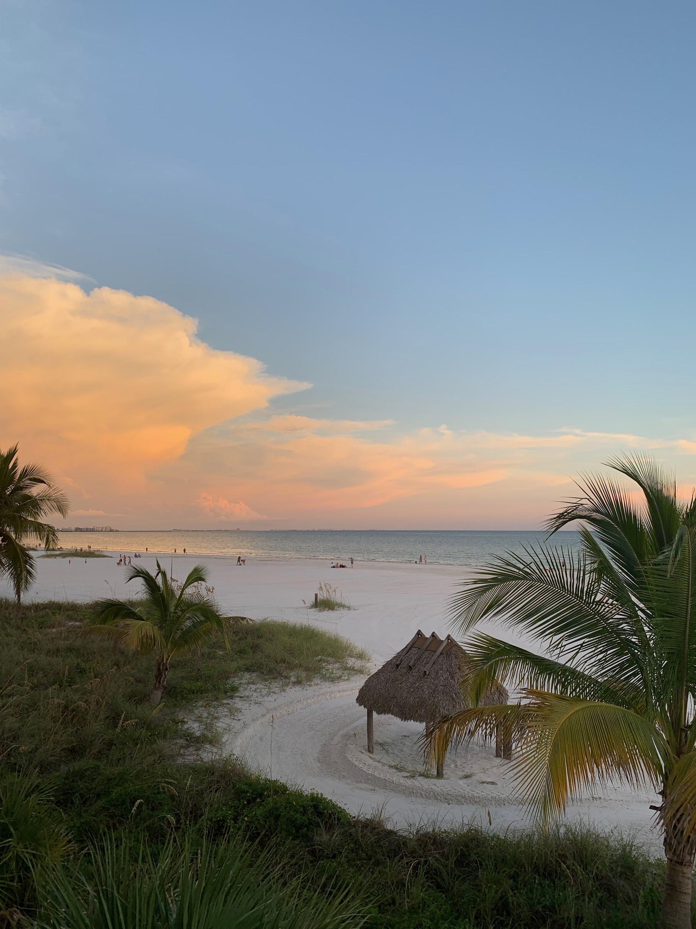
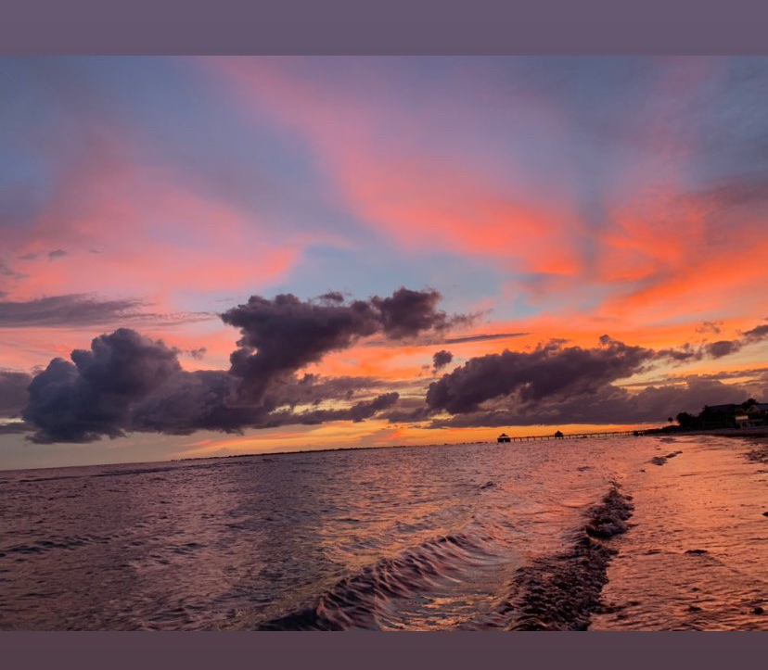
Miss Owens
Family
  2 older brothers
  1 nephew
  Mom
  Grandpa
  Fat Cat
School
  Glenbard West High School
  North Central College
  Golden Apple
Hobbies
  Traveling
    25 states & Canada
  Cooking
  Netflix
  Outdoors/biking/hiking

Slide 6
Mrs. Manzella
Self-Introduction

Slide 7
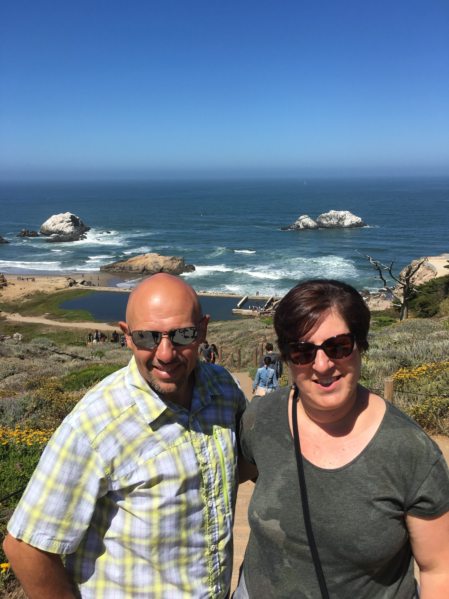
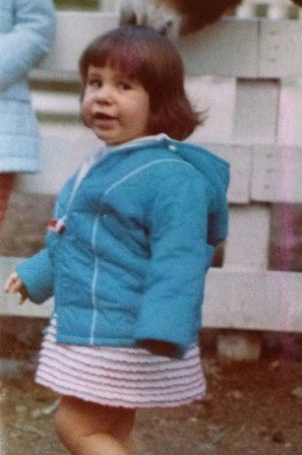
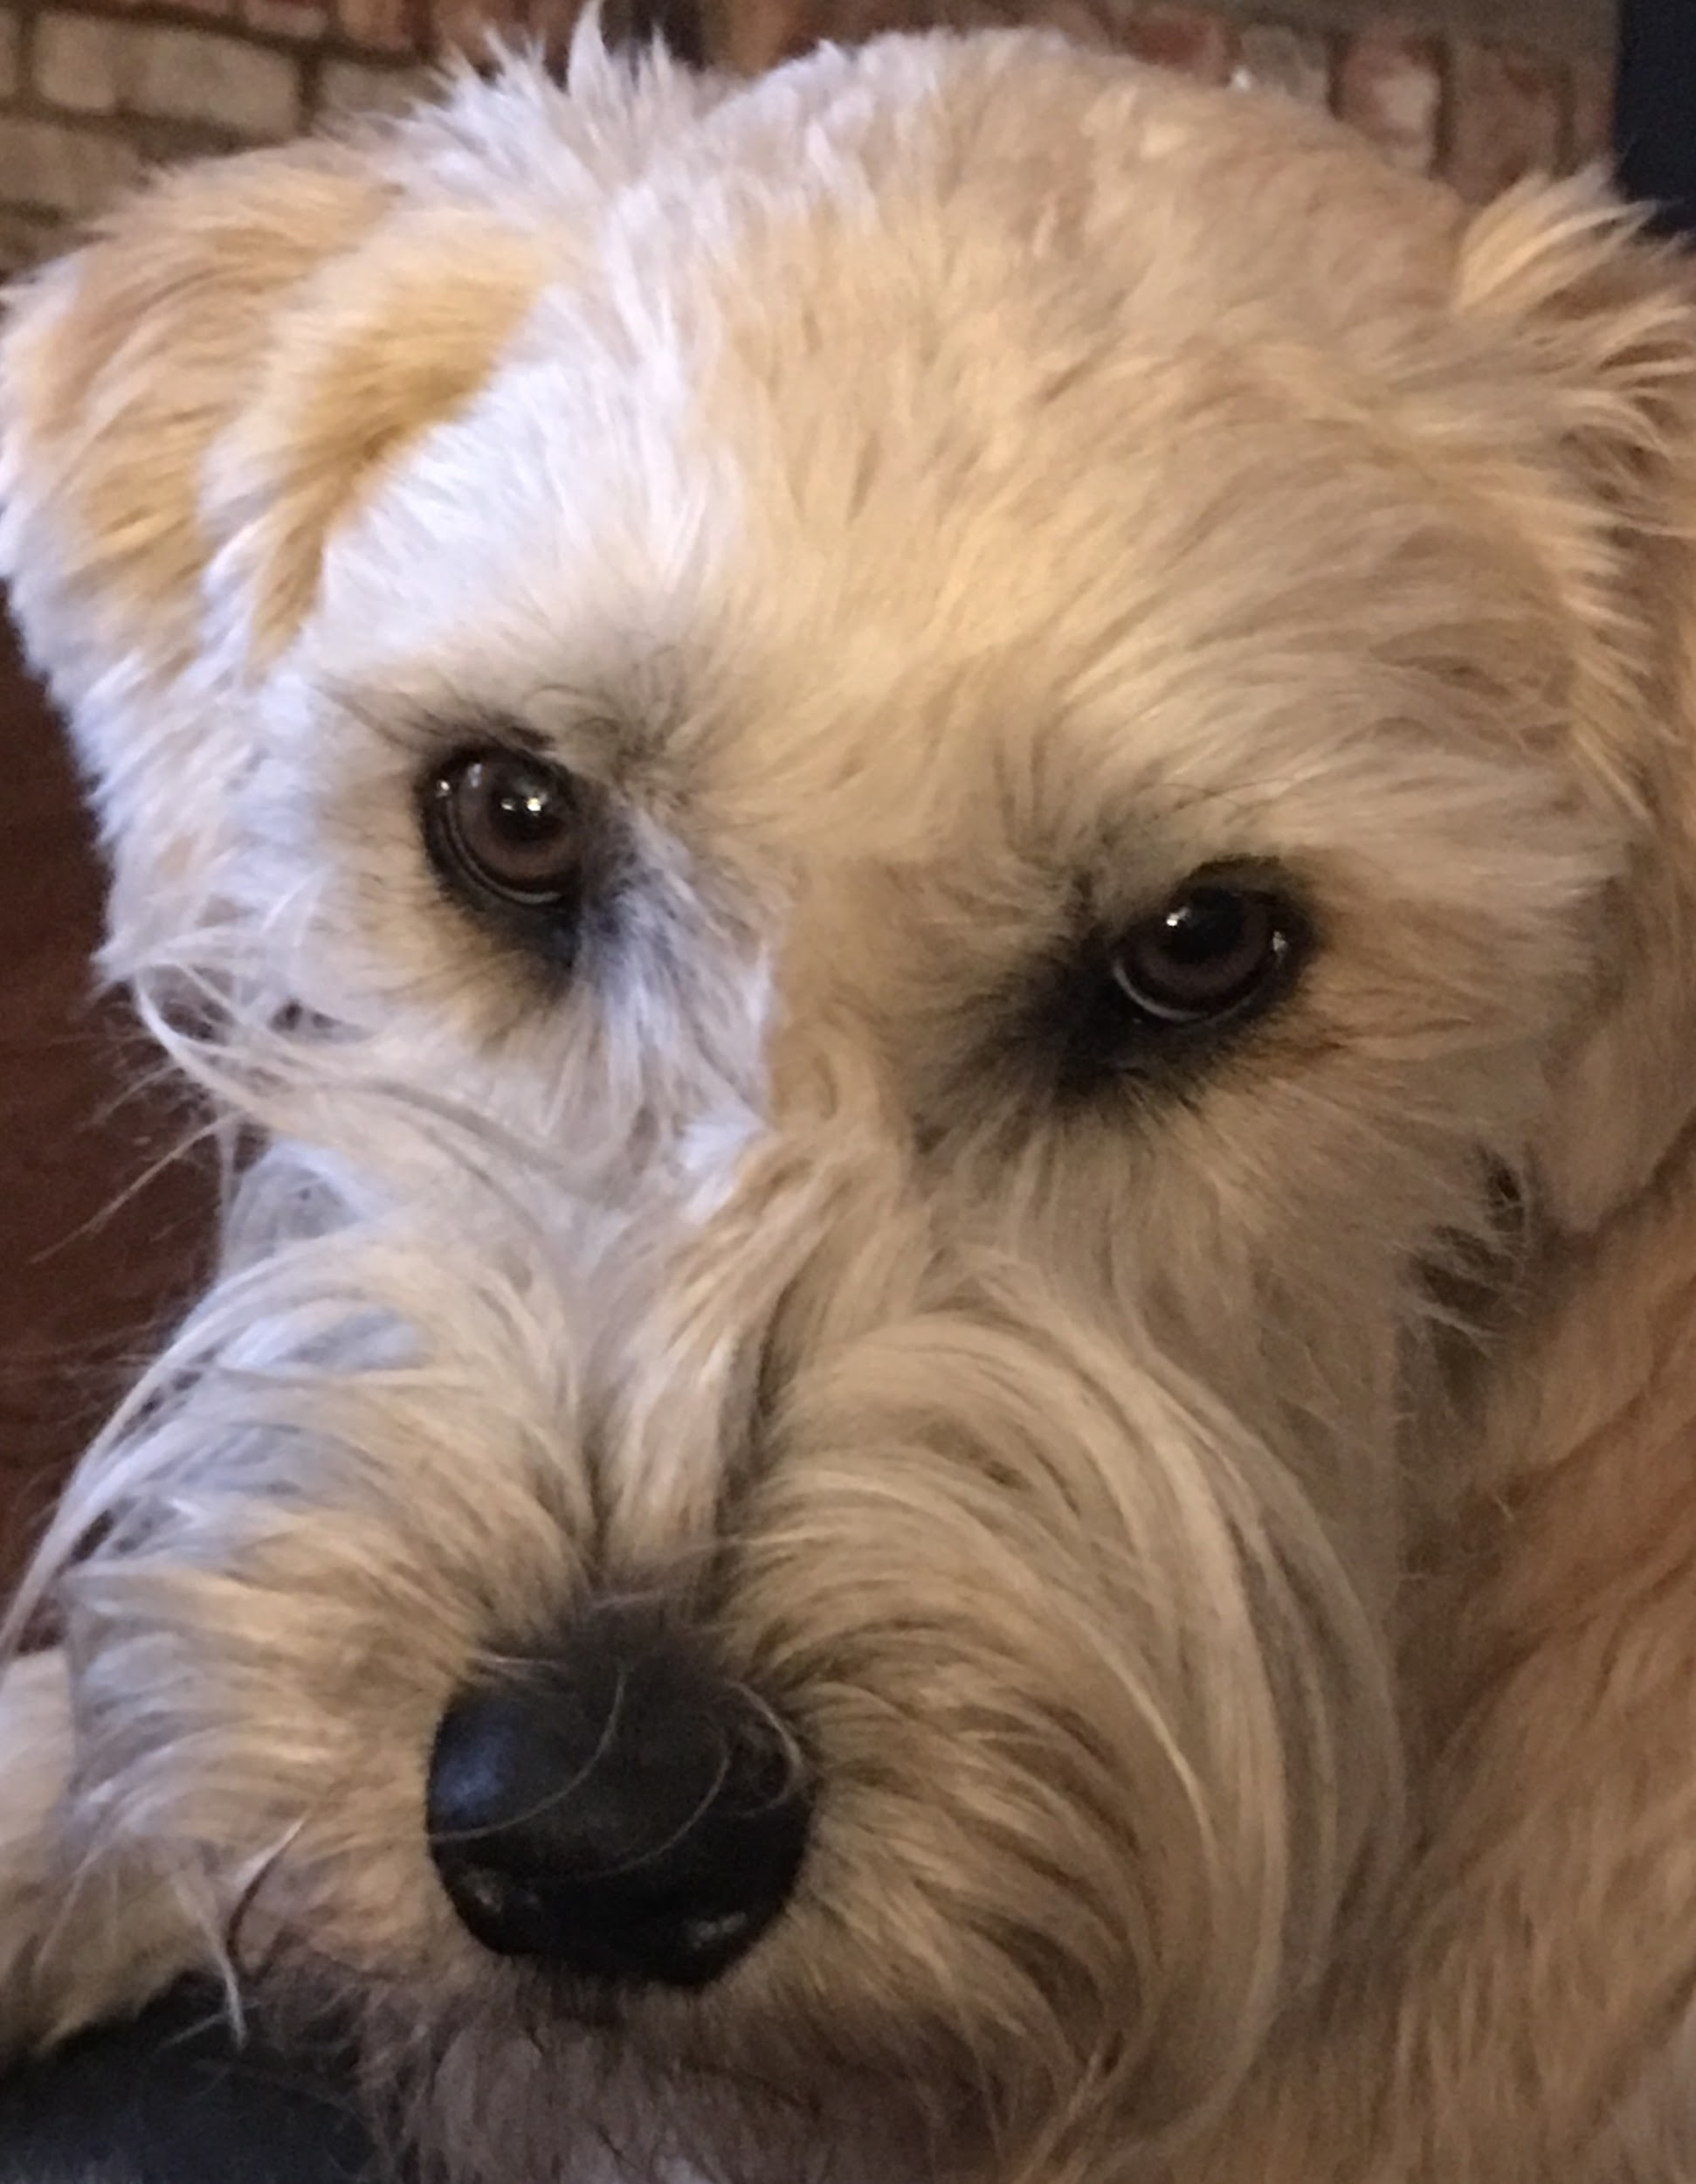
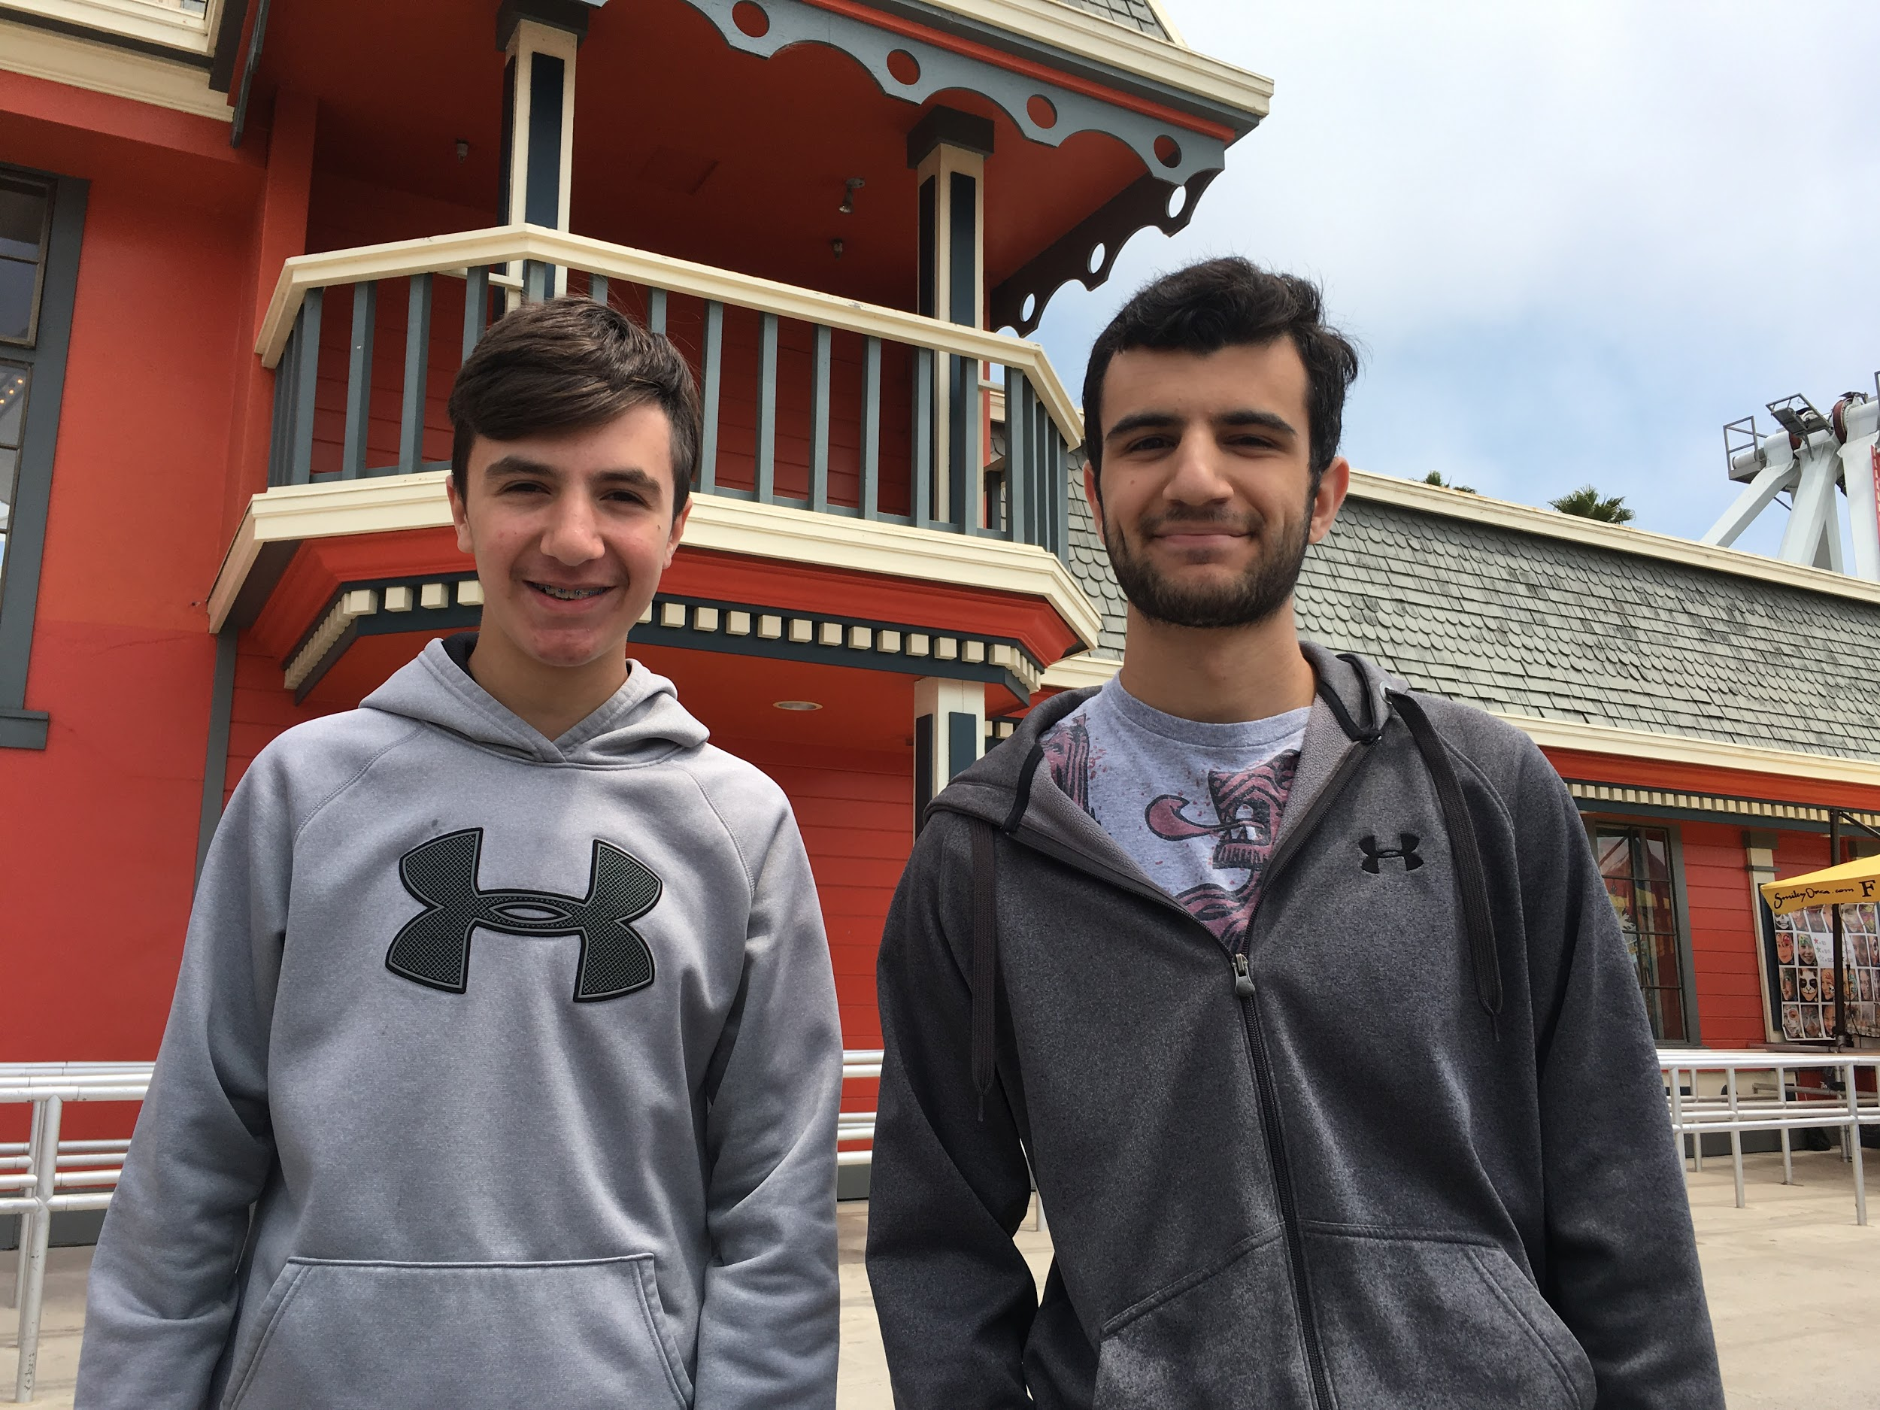
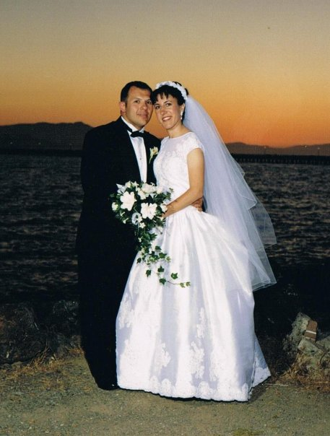
Family
Oldest of three; 1 sister, 1 brother
Married 20 years
Mario, 17
Frankie, 14
Two doggies - Luna and Cubby

Slide 8

Education
Elementary: St. John’s (grades 1 - 8)
High School: El Cerrito High School
College: San Francisco State University
Masters: Concordia University
Currently starting an ELL endorsement program through University of St. Francis

Slide 9
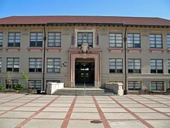

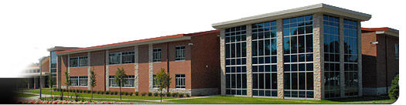
Career
Student teaching: Berkeley High School
Juan Crespi Middle School (3 years)
East Aurora High School (20 years)

Slide 10
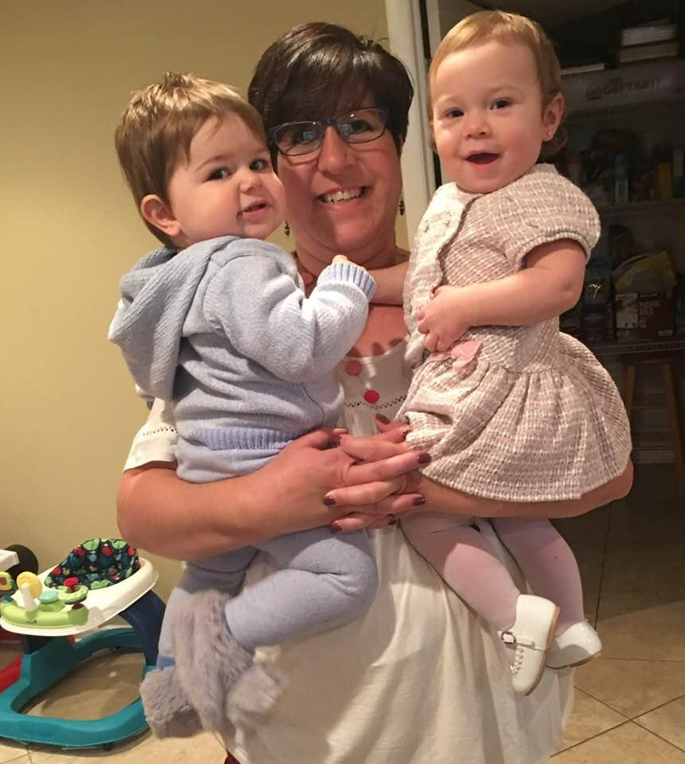
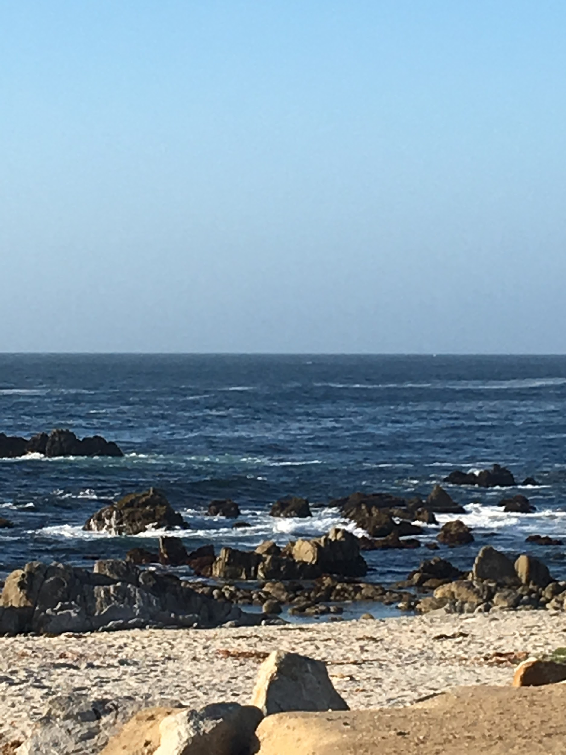

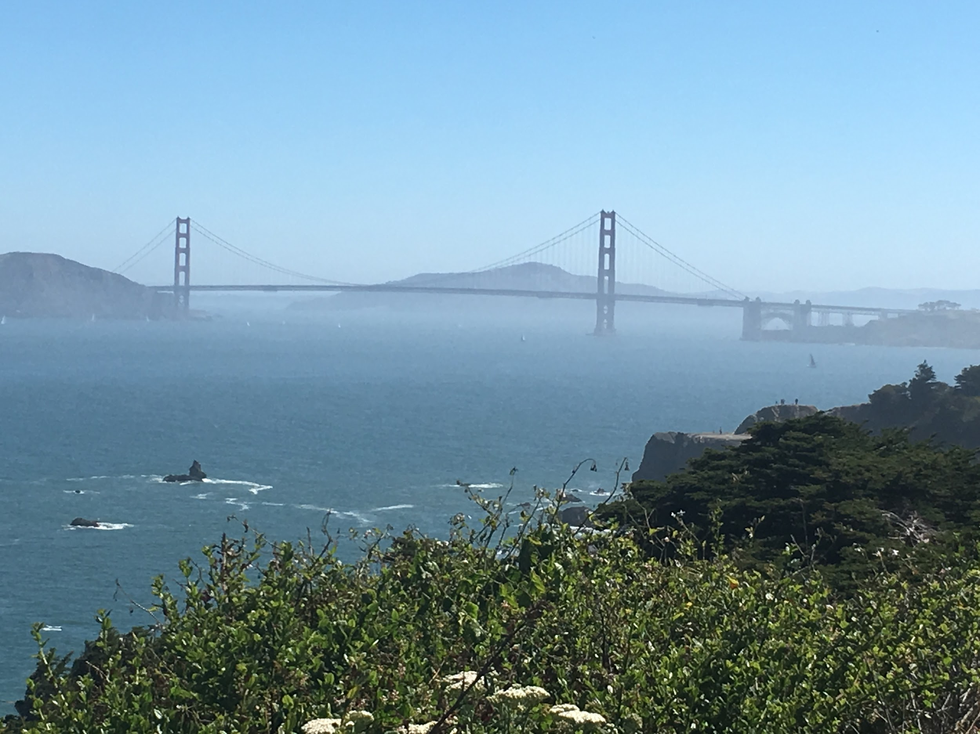
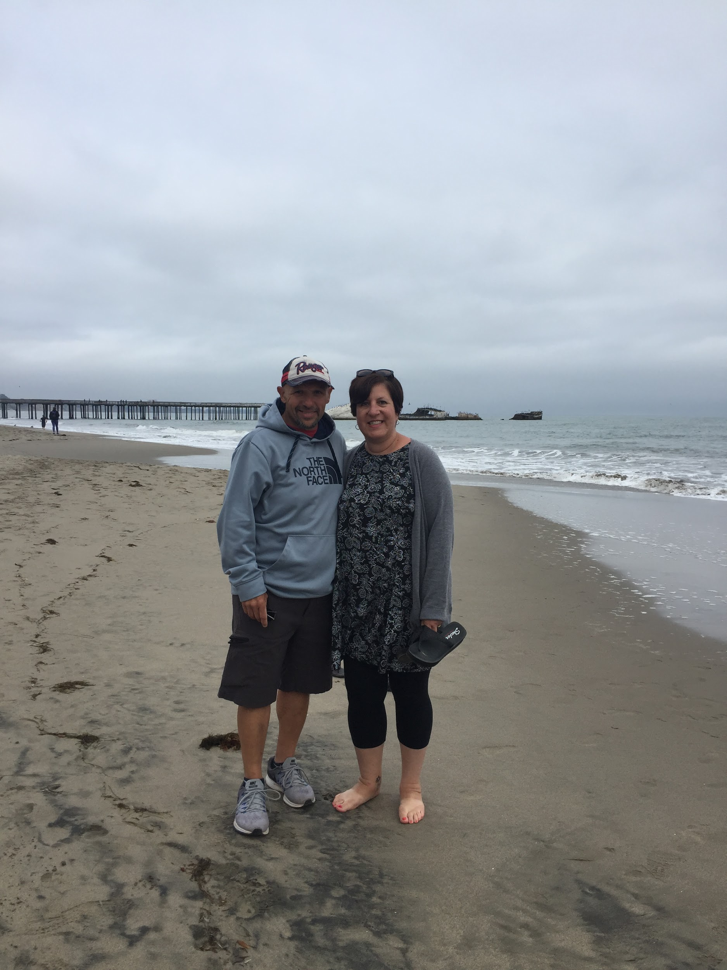


Interests
Reading fiction
Traveling, especially beaches
Babies - 3 great nephews, and two great neices

Slide 11
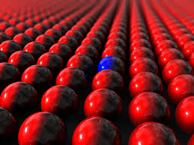
Friday, August 16th
Objectives: Students will be able to informally define the concepts of conformity and non-conformity after viewing images and video clips.
Agenda:
Conformity vs. Non-conformity
  What do they mean?
    Images and clips to guide us
  Create a definition
This or That Brainstorm
Homework: Continue working on your Introduction Slides due Tuesday

