Slide 1

Reading and Using Recipes

Slide 2
Warm-Up
What’s wrong with this recipe?
Eclairs
1/2 cup or so butter smidge of salt
1 cup flour 4 eggs
1 - 3 1/4 oz. pkg. vanilla pudding 1 cup whipped cream
vanilla extract
Preheat oven to 375 degrees F. Stew a cookie sheet. In a sauce pan shred 1 cup of water, butter and salt until mixture grinds. Reduce heat to low; vigorously sliver in flour until mixture forms a ball and leaves the side of pan. Let it cool a minute or two. Dice eggs into mixture until thoroughly toasted. Drop paste by 1/4 cupfuls onto cookie sheet. Steam each mound with knife into a 5 " x 3/4" rectangle, rounded edges. Scald for 40 minutes or until lightly barbecued. Grate a slit in the side of each shell and dice 10 minutes longer. Cool shells on wire rack. Prepare Jello pudding and sift in whipped cream and almond extract. Mince each shell and chop bottom of shells with filling. Replace tops and saute with chocolate frosting. Refrigerate until served.

Slide 3
Answers
What’s wrong with this recipe?
Eclairs
1/2 cup or so butter smidge of salt
1 cup flour 4 eggs
1 - 3 1/4 oz. pkg. vanilla pudding 1 cup whipped cream
vanilla extract
Preheat oven to 375 degrees F. Stew a cookie sheet. In a sauce pan shred 1 cup of water, butter and salt until mixture grinds. Reduce heat to low; vigorously sliver in flour until mixture forms a ball and leaves the side of pan. Let it cool a minute or two. Dice eggs into mixture until thoroughly toasted. Drop paste by 1/4 cupfuls onto cookie sheet. Steam each mound with knife into a 5 " x 3/4" rectangle, rounded edges. Scald for 40 minutes or until lightly barbecued. Grate a slit in the side of each shell and dice 10 minutes longer. Cool shells on wire rack. Prepare Jello pudding and sift in whipped cream and almond extract. Mince each shell and chop bottom of shells with filling. Replace tops and saute with chocolate frosting. Refrigerate until served.

Slide 4

So What is a
Recipe?
A set of directions for making food or beverage.

Slide 5
Types of Recipe Formats
    Standard form
      Ingredients listed first, in order of use, followed by step-by-step instructions.
    Action form
      Instructions are given, followed by the ingredient and the amount of ingredient.
    Narrative form
      Instructions, ingredients, and amounts of ingredients are given in paragraph form.
:
Copyright © Notice: The materials are copyrighted © and trademarked ™ as the property of The Curriculum Center for Family and Consumer Sciences, Texas Tech University.

Slide 6
Standard Form Recipe
Fruit Salad
    1 medium apple, chopped
    1 medium orange, peeled, membrane removed, and sectioned
    1 C green or red seedless grapes
    1 medium lemon, washed
    2 T grated, toasted coconut
    ½ c toasted, chopped pecans
  Directions:
  1. Combine chopped apple, orange sections, grapes, coconut, and pecans in large bowl.
  2. Using a fine grater, zest the yellow rind of the lemon on top of the fruit.
  3. Cut the lemon in half and squeeze the juice into the bowl with the fruit.
  4. Stir to mix zest and juice with the fruit.
  5. Chill or serve at room temperature.
Copyright © Notice: The materials are copyrighted © and trademarked ™ as the property of The Curriculum Center for Family and Consumer Sciences, Texas Tech University.

Slide 7
Action Form Recipe
Fruit Salad
  Chop:
      1 medium apple
  Peel, remove membrane, and section:
      1 medium orange
  Wash and remove from the stems:
      1 cup green or red seedless grapes
  Wash:
      1 medium lemon
  Finely grate:
      the yellow rind of the lemon
  Place all fruit and grated rind in a large bowl.
  Toast:
      2T grated coconut and ¼ c chopped pecans, cool, and add to the fruit bowl
  Cut:
      the lemon in half and squeeze the juice into the bowl with the fruit
  Stir :
      all ingredients in the bowl to mix zest and juice with the fruit
  Chill or serve at room temperature.
Copyright © Notice: The materials are copyrighted © and trademarked ™ as the property of The Curriculum Center for Family and Consumer Sciences, Texas Tech University.

Slide 8
Narrative Form Recipe
Fruit Salad
  Chop 1 medium apple, and place in a large bowl. Peel, remove the membrane, and section 1 medium orange. Add to the bowl with the chopped apple. Wash and remove from the stems 1 C green or red seedless grapes. Add to the bowl with the apple and orange. Toast 2 T of grated coconut in the oven, cool, then add to the fruit in the bowl. Toast ½ c chopped pecans, cool, then add to the fruit and coconut in the bowl. Wash 1 medium lemon. Finely grate the yellow rind of the lemon on top of the fruit. Cut the lemon in half and squeeze the juice into the bowl with the fruit, coconut, and pecans. Stir the fruit mixture. Chill or serve at room temperature.
Copyright © Notice: The materials are copyrighted © and trademarked ™ as the property of The Curriculum Center for Family and Consumer Sciences, Texas Tech University.

Slide 9

How to Use a Recipe
1. Read all directions.
2. Gather all needed equipment
and ingredients.
3. Preheat and/or complete other
pre-preparation steps.
4. Follow directions step by step.

Slide 10

What does a recipe consist of?
Six parts of a recipe

Slide 11
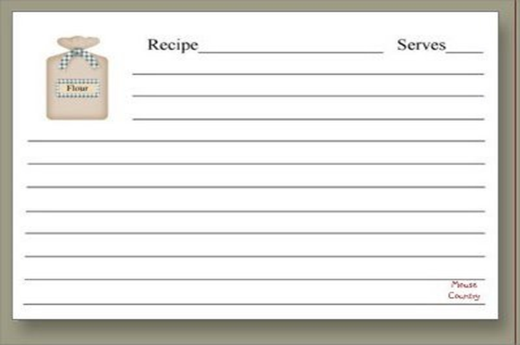

1. Yield
The yield tells the number and size of servings the recipe will make.
Why is this important?
Knowing the yield in advance helps one to know if more or less food is needed – whether or not to make more or less of the food.

Slide 12
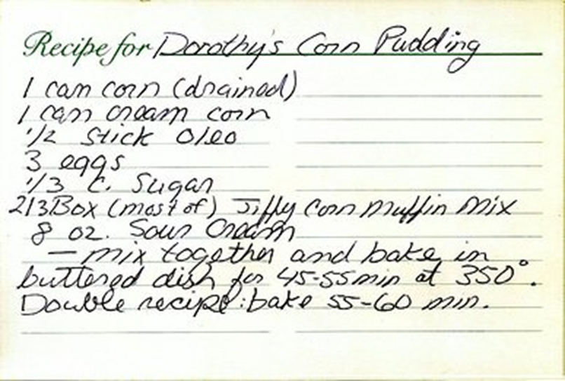
2. List of Ingredients & Amounts
Listed in the order they are used in the recipe.
Listed in the exact amount as needed.
Specific form of ingredient is also stated.
List of Ingredients & Amounts
Notes:
List of Ingredients & Amounts

Slide 13
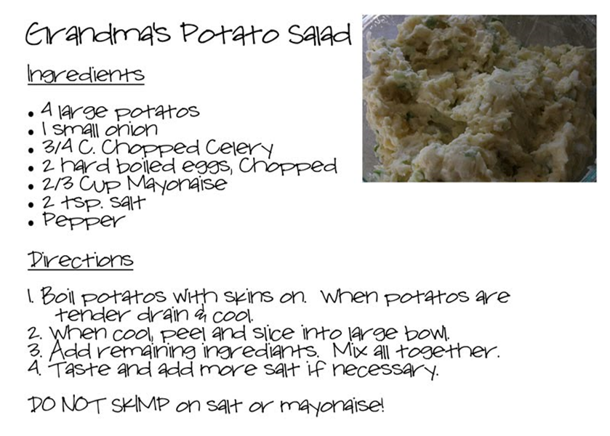
3. Step By Step Directions for Mixing &
Handling
Directions for how to prepare it.
Steps are listed in the order they should be done.
Numbered steps are
easy to follow & help
to prevent steps
from being skipped.
Some recipes are
written in paragraph
form, and should be
read & followed VERY
carefully.

Slide 14
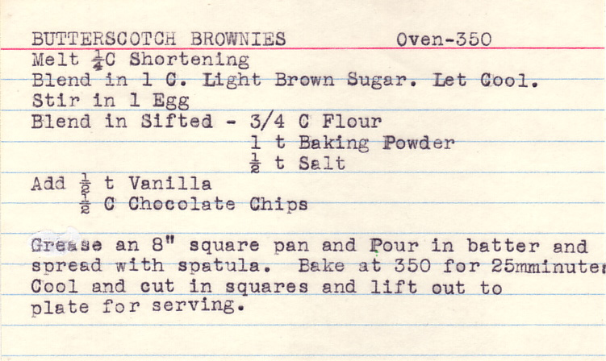
4. Equipment (Container Size & Type)
-Specific equipment such as a 8 x 8 square pan is sometimes listed.
Most recipes do not state ALL the necessary equipment. It is important to use the stated specific equipment so the food will not overflow or overcook.
Container Size

Slide 15
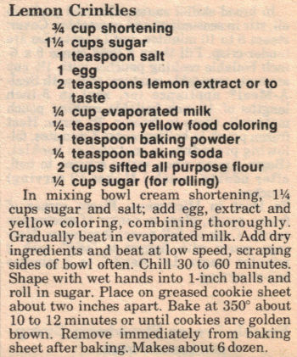
5. Temperature & Time
Give you exact cooking temperatures and times and/or will tell you how to cook the food.
Oven temperatures may vary and times are for conventional ovens unless otherwise stated.

Slide 16
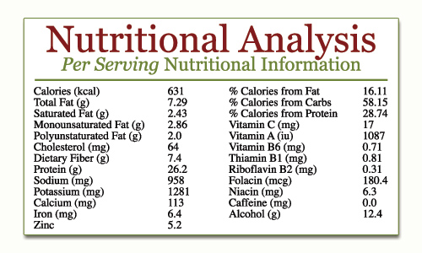
6.Nutrition Analysis (optional)
Not necessary, but it is very useful when planning food to fit into a particular eating plan.
Some recipes include number of calories and/or grams per serving of various nutrients.

Slide 17

Reading Ingredients
Now that you know what a recipe is: What about the way ingredients are listed!
Does it matter! Who wants to volunteer?
  What’s the difference between:
    ½ cup flour, sifted
    ½ cup sifted flour
Know your terms!
  Chopped, Minced, Diced,
  Sliced, Sifted, etc.

Slide 18
Can You Read a Recipe?
Part A - Read the recipe, and answer the questions on the next slide.
  Blonde Brownies
    2 c all-purpose flour
    2 t baking powder
    ¼ t salt
    ½ c butter or margarine
    2 c brown sugar
    2 eggs
    1 t vanilla
    1 c chopped nuts, optional
  Grease a 12x9x2-inch baking pan. Combine flour, baking powder, and salt; set aside. Melt butter; remove from heat. Stir in sugar. Add eggs and vanilla; stir until combined. Stir dry ingredients and nuts into sugar mixture. Spread in pan. Bake in a 350º oven for 20 to 25 minutes.
  Makes 48 brownies.
Copyright © Notice: The materials are copyrighted © and trademarked ™ as the property of The Curriculum Center for Family and Consumer Sciences, Texas Tech University.

Slide 19
Can You Read a Recipe?
Part A Questions:
What utensils or small kitchen equipment will be needed?
At what temperature should the food be baked?
How long does the food bake?
How many servings will this recipe make?
Copyright © Notice: The materials are copyrighted © and trademarked ™ as the property of The Curriculum Center for Family and Consumer Sciences, Texas Tech University.

Slide 20
Can You Read a Recipe?
    1/3 c shortening
    2 eggs
    1 T milk
    1 c mashed ripe bananas
    ¼ c chopped nuts
Part B - Read the recipe, and follow the instructions that follow.
  Banana Nut Bread
    1 ¾ c all-purpose flour
    1 ¼ t baking powder
    ½ t baking soda
    3/4 t salt
    2/3 c sugar
  Stir together flour, baking powder, baking soda, and salt. Set aside.
  In a mixer bowl, beat sugar and shortening with electric mixer until light. Scrape the sides of bowl often. Add eggs, one at a time, and the milk, beating until smooth after each addition. Fold in nuts.
  Turn batter into a lightly greased 8x4x2-inch loaf pan. Bake in a 350º oven for 60 to 65 minutes or until a wooden pick inserted near the center comes out clean. Cool in pan 10 minutes. Remove from pan; cool. For easier slicing, wrap and store overnight. Makes 1 loaf.
Copyright © Notice: The materials are copyrighted © and trademarked ™ as the property of The Curriculum Center for Family and Consumer Sciences, Texas Tech University.

Slide 21
Can You Read a Recipe?
Part B Instructions:
  Place parentheses ( ) around each ingredient of this recipe.
  Place brackets [ ] around the amount needed for each ingredient.
  Underline the temperature needed to bake this banana bread.
  Circle the instructions for this recipe.
  Place a square around the ingredients listed in order of use.
  Place a zigzag line under the pan size.
  Place a curvy line under the amount this recipe makes.
  Place a double line under the time it takes to prepare.
Copyright © Notice: The materials are copyrighted © and trademarked ™ as the property of The Curriculum Center for Family and Consumer Sciences, Texas Tech University.

Slide 22
Class discussion:
What advantages do you see for each of the formats?
What disadvantages do you see for each of the formats?
When might you use each of the three formats?
Which format do you think is the easiest to follow? Why?
Which format do you think is the most difficult to follow? Why?
Why is it important to understand cooking terms in a recipe? (Bake vs. Saute)

